Slide 2
Choosing Meaningful QAPI Studies:
Four That Work,
One to Avoid

Slide 3
Training Objectives
At the end of this Training attendees will be able to:
  Understand the history and purpose of QAPI
  Recognize what makes a good QAPI Study
  Spot a less ideal QAPI Study
  Have resources for possible QAPI Studies that might work for you
Notes:
Electronic Medical Records (EMR/EHR), prevalent in both physician practices and hospitals, are finally making their way into the ambulatory surgery center (ASC) space in a big way. Although it is not clear how many ASCs are using an EHR or how each center defines an EHR, in a recent poll held by ASCA, 55% of respondents stated they have some form of an EHR. This result was similar to the Definitive Healthcare1 result of about 50% claiming they have an EHR. For those centers not using an EHR, they stated it’s due to costs and lack of federal/state mandates. However, with increased utilization of the ASC space for surgical and procedural care and the ever increasing need to communicate patient health care information across all avenues of care, this reasoning is becoming obsolete. The growing need for healthcare access combined with consumer’s constant exposure to technology and reliance on immediate, mobile access to everything has created a tipping point for EHR adoption. Reason #1: Cost – The Price Tag is Lower Than You Think

Slide 4
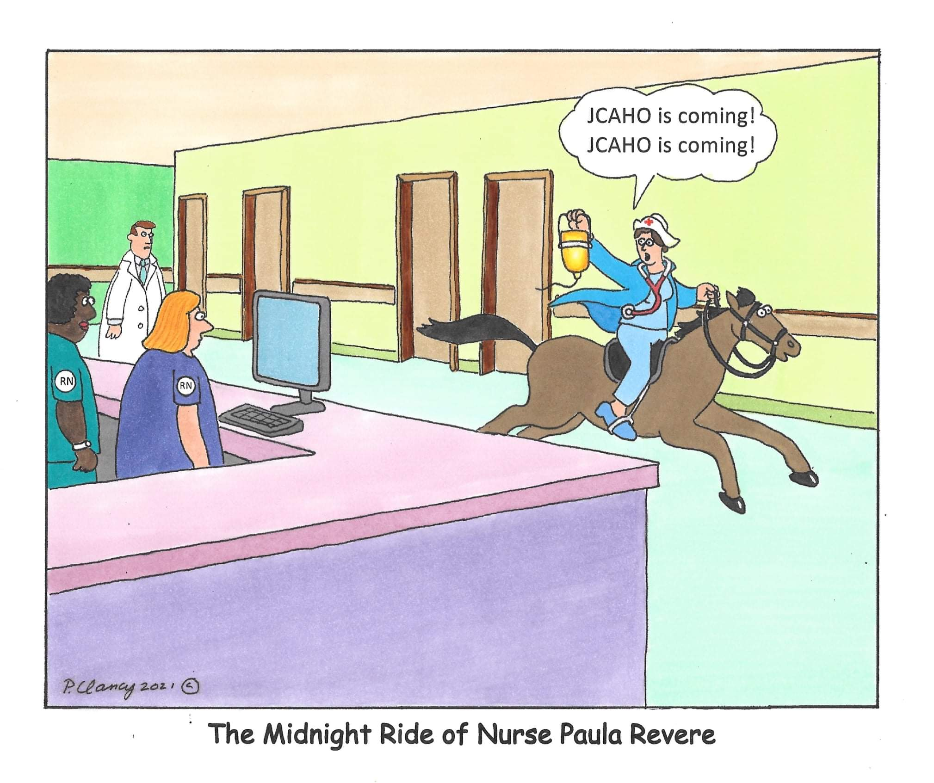
Who can relate?

Slide 5
When did QAPI become required at ASCs and why are we doing it?

Slide 6
History Lesson: When did it all begin?
In January of 2009, for the first time since 1982, CMS made significant changes to the Conditions for Coverage. These changes included:
Quality Assessment and Performance Improvement (“QAPI”) – Expanded program requirements and procedures (42 CFR § 416.43)
An ongoing comprehensive self-assessment of the quality of care provided, including medical necessity and appropriateness of care
ASC policies must reflect an “ongoing, data-driven” QAPI program – Detailed quantitative and qualitative standards prescribed, using “adequate” allocation of staff and facility resources – May eventually overlap with CMS quality reporting measurements
Notes:
According to CMS, QAPI is the coordinated application of two mutually-reinforcing aspects of a quality management system: Quality Assurance (QA) and Performance Improvement (PI). QAPI takes a systematic, comprehensive, and data-driven approach to maintaining and improving safety and quality in ambulatory surgery centers while involving all staff in practical and creative problem solving.
https://www.faegredrinker.com/webfiles/2009_Health_Care_Regulatory_Update.pdf

Slide 7
History Lesson: Where are we now?
What started as an exercise in paper and showing only the places where you knew your center would excel, has morphed into what it was intended to be: a way to improve your patient care and outcomes, your financial policies, and your building safety.
QAPI is now clearly defined with specific format and processes in place. Following the format is not difficult. Finding topics that will actually improve care and/or outcomes is not always as easy.

Slide 8
Where to start? (Part 1)
Find the topics with the most impact.
Before a subject becomes a QAPI, it must first be identified as an area or issue that actually NEEDS improvement.
Talk to your staff in both clinical and business areas. The people on the front line often know what is and isn’t working.
Read industry articles and blogs for current topics of concern
Look at the subjects you’ve done in the past 10 years. Are the outcomes still good or is it time to restudy these oldies but goodies

Slide 9
Evaluate the Study Topic
Is it a problem – the evaluation phase should identify this
Can you get the data you need to study the issue – creating the spreadsheet
Can you narrow the scope and handle the variables
Can you have quality interventions that will work
Does administration have the appetite to fix the problem
Notes:
There are a lot of criteria for evaluating a QAPI study…this is my “go-to” checklist.

Slide 10
Where to start? (Part 2)
Follow the steps.
Problem identified: What is the suspected problem/concern?
Identification of performance measures/goals/objectives: What needs to be done to correct the problem/concerns? What is the goal to accomplish?
Research/gather data: What is the frequency, severity and source of the suspected problem/concerns?
Implementation of corrective action: What was done?
Re-measurements/re-evaluation: Was the desired goal achieved or should alternatives be considered?
Identification, analysis and implementation of any additional corrective actions: If the original corrective action did not resolve the problem, what is the next step?
Conclusion: The results of the study are evaluated, and a conclusion is reached. Results are reported as appropriate.

Slide 11
Example #1
Area of Care:
Infection Control
Notes:
Why do they work? They are actual problems, they are measurable, and perhaps where some folks go awry, you can do things to change the outcome and sometimes solve the issue.

Slide 12
#1 Area of Care: Infection Control
TOPIC: ADHERENCE TO THE POLICY FOR CLEANING BETWEEN PATIENTS IN PRE-OP
Statement of the purpose: Cleaning between patients in the Pre-op area consists of wiping all surfaces of the stretchers with use of approved cleaning solutions for the specified amount of time.
  Improper cleaning or use of cleaning products improperly could increase center acquired infections
  It could increase the cost of care for the patient
  May affect patient satisfaction
Notes:
This study was recommended by a pre-op nurse who noticed that the stretchers were being wiped and immediately covered in new sheets without waiting the required 3 min dry time. Although this study was conducted a few years ago, it is still relevant in the new COVID world.

Slide 13
#1 Area of Care: Infection Control
TOPIC: ADHERENCE TO THE POLICY FOR CLEANING BETWEEN PATIENTS IN PRE-OP
Performance goal:
When reviewing the pre-op cleaning process for the past 2 weeks, the data showed that proper cleaning procedure and dry time was performed 50% of the time. The goal will be to follow the proper process 100% of the time
Attach the policy.
Notes:
Remember we are dealing with human beings and circumstances beyond their control. Set a goal that is reachable and reproducible. However, when you are studying rates of compliance with a particular policy, your goal might be to have 100% compliance.

Slide 14
#1 Area of Care: Infection Control
TOPIC: ADHERENCE TO THE POLICY FOR CLEANING BETWEEN PATIENTS IN PRE-OP
Description of the data:
Data collection occurred from April 1, 20XX – April 15, 20XX.
Total number of patients was 630.
A checklist of cleaning process for each stretcher was kept.
The percent of adherence to policy/procedure was calculated by dividing the number of patients for the two-week time frame by the number of correct cleaning processes.

Slide 15
#1 Area of Care: Infection Control
TOPIC: ADHERENCE TO THE POLICY FOR CLEANING BETWEEN PATIENTS IN PRE-OP
Evidence of data collection:
Data was collected using an excel spreadsheet for each day and completed by the Peri-operative manager.
Each stretcher was tracked by number, the staff who cleaned and the observer.
It included product used, a checklist of items cleaned, and dry time as required.
Attach the appropriate spreadsheet.
Notes:
How do you know…evaluate the issue first. What was miss

Slide 16
#1 Area of Care: Infection Control
TOPIC: ADHERENCE TO THE POLICY FOR CLEANING BETWEEN PATIENTS IN PRE-OP
Data analysis:
Trends: 630 total stretchers were cleaned during the time frame. Appropriate cleaning methods were used 50% of the time.
Severity: All patients during this time frame were potentially exposed to contaminated stretchers.
Analysis: The number of stretchers available was not sufficient to allow for the appropriate cleaning and continuous use by the quickly moving stream of patients. The aides and staff stated that the turnover time did not allow for full dry time or complete stretcher wipe down.
Notes:
Remember we are dealing with human beings and circumstances beyond their control. Set a goal that is reachable and reproducable. However, when you are studying rates of compliance with a particular policy, your goal might be to have 100% compliance.

Slide 17
#1 Area of Care: Infection Control
TOPIC: ADHERENCE TO THE POLICY FOR CLEANING BETWEEN PATIENTS IN PRE-OP
A comparison of performance against identified performance goal:
Data showed that the cleaning of stretchers in accordance with policy and procedure was 50%,less than half the goal of 100%
Notes:
Remember we are dealing with human beings and circumstances beyond their control. Set a goal that is reachable and reproducable. However, when you are studying rates of compliance with a particular policy, your goal might be to have 100% compliance.

Slide 18
#1 Area of Care: Infection Control
TOPIC: ADHERENCE TO THE POLICY FOR CLEANING BETWEEN PATIENTS IN PRE-OP
Implementation of corrective actions(s) to resolve identified problem(s):
4 additional stretchers will be ordered
Research to find cleaning solutions with shorter dry time that is approved by the stretcher manufacture.
Responsible staff will review the cleaning policy and procedures for stretchers.
Timer placed at each stretcher cleaning station

Slide 19
#1 Area of Care: Infection Control
TOPIC: ADHERENCE TO THE POLICY FOR CLEANING BETWEEN PATIENTS IN PRE-OP
Re-measurement:
After implementation of corrective action, a re-measurement was conducted for 2 weeks starting August 1 thru August 15. 580 stretchers were cleaned with a 98% adherence to policy. 196% improvement.
If the initial corrective actions did not reach the goal, do not simply repeat the study. Change or add to the corrective action and repeat.
*If the initial corrective actions DID achieve success, then repeat the study quarterly or annually to assure resolution of the original issue.

Slide 20
#1 Area of Care: Infection Control
TOPIC: ADHERENCE TO THE POLICY FOR CLEANING BETWEEN PATIENTS IN PRE-OP
Communication of the findings
Findings of the QI activity were presented to the QAPI committee on Sept. 1, 20XX and then to the quarterly Executive Committee on Sept. X, 20XX. The meeting minutes and recommendations were presented to the Board of Managers at their monthly meeting.
Re-measurement findings will be presented similarly.
Results were discussed with all staff at the bi-weekly staff meeting.

Slide 21
#1 Area of Care: Infection Control
TOPIC: ADHERENCE TO THE POLICY FOR CLEANING BETWEEN PATIENTS IN PRE-OP
Why did this topic work?
Meaningful to patients, staff, and center
Measurable
Intervention possible
Corrective action sustainable

Slide 22
Example #2
Area of Care:
HIPAA Compliance
Notes:
Paper world…
Echart world

Slide 23
#2 Area of Care: HIPAA Compliance
TOPIC: ADHERENCE TO THE POLICY FOR CHART ACCESS
Statement of the purpose: Compliance with the Health Insurance Portability and Accountability Act of 1996 (HIPAA) as it relates to chart access and security of data should be strictly enforced.
Allowing universal access to all personnel could cause PHI data leaks and resulting fines
May affect patient satisfaction
May result in litigation depending on use of the data
Notes:
Paper world…
Echart world

Slide 24
#2 Area of Care: HIPAA Compliance
TOPIC: ADHERENCE TO THE POLICY FOR CHART ACCESS
Performance goal:
When reviewing chart access for the past 4 weeks, the data showed that chart access was left unmonitored 16% of the time. The goal will be to monitor chart access 100% of the time.
*attach the policy
Notes:
Where did this number come from….it was your evaluation of the proposed issue prior to the start of the Study

Slide 25
#2 Area of Care: HIPAA Compliance
TOPIC: ADHERENCE TO THE POLICY FOR CHART ACCESS
Description of the data:
Data collection occurred from Jan 3, 20XX to Feb, 2 20XX.
Total number of business days was 24.
The number of times the records room was left open and unattended was ascertained via the door camera and a log was kept daily.
The percent was determined by the number of unmonitored hours divided by the number of accessible hours for the month.
Notes:
Permissions based in eChart EHR world – Data collection occurred from Jan 3, 20XX to Feb. 2, 20XX. Via the audit log (run daily), user access was matched against chart retrieval and users’ involvement in the case. The percent of adherence to policy was calculated by dividing the number of inappropriate retrievals divided by the number of charts for the month.

Slide 26
#2 Area of Care: HIPAA Compliance
TOPIC: ADHERENCE TO THE POLICY FOR CHART ACCESS
Evidence of data collection:
Data was collected using an excel spreadsheet.
There were 24 business days where the Records Room was open.
The log tracked by minutes each time the door was left open but unmonitored; who was on duty; who entered the room; how long they were in the room.
Attach the appropriate spreadsheet.

Slide 27
#2 Area of Care: HIPAA Compliance
TOPIC: ADHERENCE TO THE POLICY FOR CHART ACCESS
Data analysis:
Trends: The Record Room door was left unmanned for ten to 15 minutes multiple times during each day. No particular individual accessed the room. Two staff were identified as leaving the room open and unobserved.
Severity: Significant gaps in the protections of patients PHI was noted. X% of available hours where possible inappropriate access could have been attempted.
Analysis: The personnel monitoring access were not given relief and did not close/lock the door when they needed to leave. The staff stated that when they were leaving for just a few minutes, they found securing the door was time consuming and had too many steps.

Slide 28
#2 Area of Care: HIPAA Compliance
TOPIC: ADHERENCE TO THE POLICY FOR CHART ACCESS
A comparison performance against the performance goal:
Data showed that the access to the records room in accordance with policy and procedure was 84% compared to the 100% required to meet the goal.

Slide 29
#2 Area of Care: HIPAA Compliance
TOPIC: ADHERENCE TO THE POLICY FOR CHART ACCESS
Implementation of corrective actions(s) to resolve identified problem(s):
Policy reviewed with all staff and providers
Additional staff designated as “relief” staff for the Records Room
New key card entry put on the door and cards given to select personnel
Camera to be installed in the records room

Slide 30
#2 Area of Care: HIPAA Compliance
TOPIC: ADHERENCE TO THE POLICY FOR CHART ACCESS
Re-measurement:
After implementation of corrective actions, a re-measurement was conducted for one month June 1 – July 1, 20XX.
178 hours were available for Records room access. Room was monitored for access 100% of the open time.
Notes:
Involve all the key players in your solution.

Slide 31
#2 Area of Care: HIPAA Compliance
TOPIC: ADHERENCE TO THE POLICY FOR CHART ACCESS
If the initial corrective actions did not achieve and/or sustain the desired improved performance, implementation of additional corrective actions and continued remeasurement until the problem is resolved or is no longer relevant.
The initial goal of 100% compliance was achieved. In X months, the study will be repeated for 1 month to ensure the goal has been sustained.
Notes:
Involve all the key players in your solution.

Slide 32
#2 Area of Care: HIPAA Compliance
TOPIC: ADHERENCE TO THE POLICY FOR CHART ACCESS
Communication of the findings
Findings of the QI activity were presented to the QAPI committee on March 1, 20XX and then to the quarterly Executive Committee on March X, 20XX. The meeting minutes and recommendations were presented to the Board of Managers at their monthly meeting.
Re-measurement findings will be presented similarly.
Results were discussed with all staff at the bi-weekly staff meeting.
Notes:
Show the meeting minutes…attach a copy to the study.

Slide 33
#2 Area of Care: HIPAA Compliance
TOPIC: ADHERENCE TO THE POLICY FOR CHART ACCESS
Why did this topic work?
Meaningful to patients, staff, and center
Measurable
Intervention possible
Corrective action sustainable

Slide 34
Example #3
Area of Care:
Clinical Quality of Care
Notes:
Paper world…
Echart world

Slide 35
#3 Area of Care: Clinical Quality of Care
TOPIC: IV STARTS
A statement of the purpose:
Provide the best clinical care to patients requiring an IV and identify staff in need of additional training.
Affects patient satisfaction
May result in bruising, edema and infection
Notes:
Why does it work? Measurable, interventions available

Slide 36
#3 Area of Care: Clinical Quality of Care
TOPIC: IV STARTS
Identification of the performance goal:
When reviewing chart access for the past 4 weeks, the data showed that IV starts occurred on the 3rd or more attempt X% of the time.
The goal will be to reduce IV start attempts by 90%.
Attach a policy or standard
Notes:
Do you follow a standard of care or have a policy?

Slide 37
#3 Area of Care: Clinical Quality of Care
TOPIC: IV STARTS
Evidence of Data Collection:
Data was collected using an excel spreadsheet. There were 20 Surgery days where one or more patients required an IV. Date of service, Medical Record number, Clinician, attempts by clinician, total number of attempts for patient, patient’s NPO status in hours.
Attach your excel sheet

Slide 38
#3 Area of Care: Clinical Quality of Care
TOPIC: IV STARTS
Data Analysis:
Trends: IVs were started in 2 or less sticks 80%. 3 clinicians were identified at unable to start the IV in 2 or less sticks in a majority of the outliers.
Severity: The number of patients affected was 5
Analysis: The nurses with less effective IV start rate were new hires who had less than 1 year in perioperative care at an Ambulatory Surgery Center.

Slide 39
#3 Area of Care: Clinical Quality of Care
TOPIC: IV STARTS
A comparison performance against the performance goal:
Data showed that the adherence with standard and policy was 80% compared to the 90% required to meet the goal.

Slide 40
#3 Area of Care: Clinical Quality of Care
TOPIC: IV STARTS
Implementation of corrective actions:
Inservice given to all staff
One on one training provided to identified staff
New staff orientation to now include this training
Difficult stick IV team created

Slide 41
#3 Area of Care: Clinical Quality of Care
TOPIC: IV STARTS
Re-measurement:
After implementation of corrective actions, a re-measurement was conducted for one month June 1 – July 1, 20XX.
X patients required an IV start.

Slide 42
#3 Area of Care: Clinical Quality of Care
TOPIC: IV STARTS
The initial goal of 90% compliance was achieved.
In X months, the study will be repeated for 1 month to ensure the goal has been sustained.

Slide 43
#3 Area of Care: Clinical Quality of Care
TOPIC: IV STARTS
Communication of the findings:
Findings of the QI activity were presented to the QAPI committee on March 1, 20XX and then to the quarterly Executive Committee on March X, 20XX.
The meeting minutes and recommendations were presented to the Board of Managers at their monthly meeting.
Re-measurement findings will be presented similarly.
Results were discussed with all staff at the bi-weekly staff meeting.

Slide 44
#3 Area of Care: Clinical Quality of Care
TOPIC: IV STARTS
Why did this topic work?
Meaningful to patients, staff, and center
Measurable
Intervention possible
Corrective action sustainable

Slide 45
Example #4
Area of Care:
Business Office
Notes:
Paper world…
Echart world

Slide 46
#4 Area of Care: Business Office
TOPIC: NO SURPRISE BILLING POLICY
A statement of the purpose: Adhere to the new Federal law regarding No Surprise Billing via the new Center policy and procedures
Affects patient satisfaction
Affects accounts and upfront fee collections
Affects CMS certification

Slide 47
#4 Area of Care: Business Office
TOPIC: NO SURPRISE BILLING POLICY
Identification of the performance goal:
This is a new policy for the Center. We will set the performance goal at 100% but expect a learning curve during the initial phase of data collection. Data will be collected and analyzed weekly.
Attach the policy

Slide 48
#4 Area of Care: Business Office
TOPIC: NO SURPRISE BILLING POLICY
Evidence of Data Collection:
Data was collected using and excel spreadsheet. There were surgery days where one or more patients required an estimate during the 2-week study.
Date of service, Medical Record number, reason for estimate, Provider(s), patient notification method and date, issues/complications and deviations from policy.
Attach report

Slide 49
#4 Area of Care: Business Office
TOPIC: NO SURPRISE BILLING POLICY
Data Analysis:
Trends: Policy was adhered to 90% of the time
Severity: The number of patients affected was 5
Analysis: Adherence to the new policy was good but did not meet with the goal of 100%

Slide 50
#4 Area of Care: Business Office
TOPIC: NO SURPRISE BILLING POLICY
A comparison performance against the performance goal:
Data showed that the accordance with standard and policy was 90% compared to the 100% required to meet the goal.

Slide 51
#4 Area of Care: Business Office
TOPIC: NO SURPRISE BILLING POLICY
Implementation of corrective actions:
Inservice given to all staff outlining new polity and No Surprise Billing Act
Business office given more intensive training
New staff orientation to now include this training
Committee established to review and decide on best procedure to assure compliance moving forward
Notes:
Purchase supporting software.

Slide 52
#4 Area of Care: Business Office
TOPIC: NO SURPRISE BILLING POLICY
Re-measurement:
After implementation of corrective actions, a re-measurement was conducted weekly.
X patients required an email, text, or phone call of expected charges.

Slide 53
#4 Area of Care: Business Office
TOPIC: NO SURPRISE BILLING POLICY
The initial goal of 100% compliance was achieved for the next 2 weeks.
In 3 months, the study will be repeated for 1 month to ensure the goal has been sustained.

Slide 54
#4 Area of Care: Business Office
TOPIC: NO SURPRISE BILLING POLICY
Communication of the findings:
Findings of the QI activity were presented to the QAPI committee on March 1, 20XX and then to the quarterly Executive Committee on March X, 20XX.
The meeting minutes and recommendations were presented to the Board of Managers at their monthly meeting.
Re-measurement findings will be presented similarly.
Results were discussed with all staff at the bi-weekly staff meeting.

Slide 55
#4 Area of Care: Business Office
TOPIC: NO SURPRISE BILLING POLICY
Why did this topic work?
Meaningful to patients, staff, and center
Measurable
Intervention possible
Corrective action sustainable
Notes:
New policies can often be studies.

Slide 56
QAPI Examples
That Just Don’t Work!
Notes:
Why do they work? They are actual problems, they are measurable, and perhaps where some folks go awry, you can do things to change the outcome and sometimes solve the issue.

Slide 57
What Doesn’t Work and Why
Is it a problem – the evaluation phase should identify this
Can you get the data you need to study the issue – creating the spreadsheet
Can you narrow the scope and handle the variables
Can you have quality interventions that will work
Does administration have the appetite to fix the problem

Slide 58
Patient “No Shows”
Is it a problem – the evaluation phase should identify this
Can you get the data you need to study the issue – creating the spreadsheet
Can you narrow the scope and handle the variables
Can you have quality interventions that will work
Does administration have the appetite to fix the problem
Notes:
Can you implement change here even if you know why people don’t show up?

Slide 59
Late Starts
Is it a problem – the evaluation phase should identify this
Can you get the data you need to study the issue – creating the spreadsheet
Can you narrow the scope and handle the variables
Can you have quality interventions that will work
Does administration have the appetite to fix the problem
Notes:
How to make this a more effective study? Drop reason “dr late”

Slide 60
Equipment Storage
Is it a problem – the evaluation phase should identify this
  Do I need a QAPI to fix it?
Can you get the data you need to study the issue – creating the spreadsheet
Can you narrow the scope and handle the variables
Can you have quality interventions that will work
Does administration have the appetite to fix the problem
Notes:
This one is less obvious, the answer is yes to all of the above. But if the solution is buy 4 additional prep tables and 2 stools and the issue is resolved, this is not a QAPI, this is a inventory issue quickly resolved.

Slide 61
What can I use for a
QAPI study this time?
Notes:
Paper world…
Echart world

Slide 62

We’ve all been there!

Slide 63
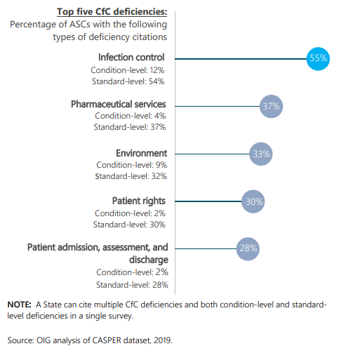
Ideas For Your Next Study
Remember, you can create a study to address ANY issue or area needing improvement.
Here are some ideas.

Slide 64
Ideas For Your Next Study
Pathology – lost specimens or results review
Cecum Study
Interpreter study – was English a primary language, was an interpreter needed; was one provided, who/what/when; was the patient/family satisfied.
No Surprise act – are you adhering to your new policy
COVID Policy adherence (PPE, new cleaning processes…)
Wait times – Reducing lobby wait times and improving patient satisfaction
Same day cancelations by dr/specialty, PAT nurse
On time Starts
Hand Hygiene
Safe Injection Practice compliance
IV starts
Notes:
A final way ASCs can miss the mark is believing that the topic for a study performed by another ASC is an appropriate topic for themselves. Just because another ASC is experiencing an issue worthy of attention—and a study—does not mean your ASC is experiencing the same issue. With that said, there is no harm in starting to track the subject to determine whether you might have a similar problem and, thus, an issue worthy of study.

Slide 65
Ideas For Your Next Study
Cost Analysis of: supplies/cost per case, equipment, medications, linens, paid staff hours/case, general cost per case
Infection Control Practices by Staff: hand hygiene, cleaning/disinfecting practices (following manufacturer directions), terminal cleanings/room cleanings, wearing PPE, tracking infection trends, root-cause analysis on infections or significant complications, etc.
Instrument Processing Practices: following manufacturer directions with cleaning agents, equipment, instruments, assembling packs, running sterilization times, spore testing, sterilization indicator strips, logging & tracking all information.
Address Risk Assessment Issues: slippery or uneven floors, sharps/blade evaluations, managing sharps on sterile field, using PPE, appropriate patient screening & selection for ASC setting, trends in staff injuries, pt transfers, etc.
Use benchmarking results and internal benchmarking: comparing your facility with national/State benchmarks, comparing your internal benchmarks quarter over quarter, year over year
Aging A/R Analysis & Improvement
Notes:
A final way ASCs can miss the mark is believing that the topic for a study performed by another ASC is an appropriate topic for themselves. Just because another ASC is experiencing an issue worthy of attention—and a study—does not mean your ASC is experiencing the same issue. With that said, there is no harm in starting to track the subject to determine whether you might have a similar problem and, thus, an issue worthy of study.

Slide 66
Thank you.
Maura Cash RN, BSN, CASC
Vice President of Clinical Strategies
e. maura.cash@hstpathways.com
m. 804.908.4444
p. 800.290.4078 Ext. 111
HST PATHWAYS | March 9 ,2022

