Slide 1
Building A Robotic Program

Slide 2
Objectives
Describe components of building a total joint program using robotics
List infection prevention strategies for total joints
Identify criteria for patient selection and successful outcomes in an outpatient joint program
Notes:
Good afternoon, it is my pleasure to be talking to you this afternoon. Today I get the opportunity to speak about our TRIA experience, how we started with outpatient joint replacement and Dr. Huang will talk more about our outpatient robotic assisted total joint arthroplasty. Hopefully by the end of our talk, you will understand how we started our robotics program, and understand a bit more on how we continue to build our outpatient arthroplasty program.

Slide 4
Dr. Andrew Mulder, Orthopedic Surgeon, St. Cloud Orthopedics
Amy Zanoth, OR Manager, St. Cloud Surgical Center
Darci Nagorski, Administrator, St. Cloud Surgical Center

Slide 5
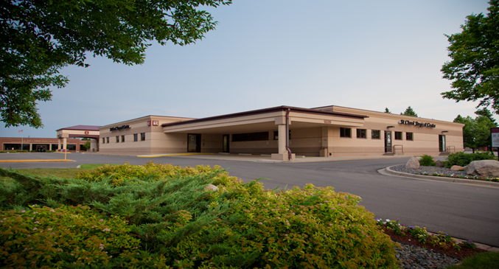
Founded in 1972 – 1st ASC in Minnesota, 2nd in the Nation
11 Operating Room, 43,000 Square Foot Facility
The only independent multispecialty ASC in the market
The only orthopedic surgical site-of-service option to CentraCare St Cloud Hospital
Center performs over 9,000 procedure annually
Promotes physician independence through key partnerships
St Cloud Orthopedics
St Cloud ENT
70 + physician partners and utilizers
Performed over 4,000 joint replacements since 2014
Program highlights
AAAH Accredited
AAAHC Advanced Orthopedic Certification in-process
AJRR Enrollee
BCBS Blue Distinction Knee & Hip Designation

Slide 6
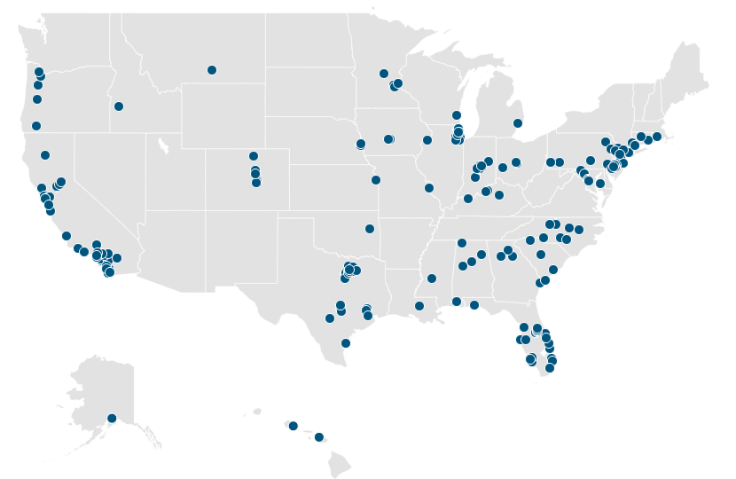
3,500+ Physician Partners | 250+ Partnered Facilities | 1M+ Surgical Procedures

Slide 7
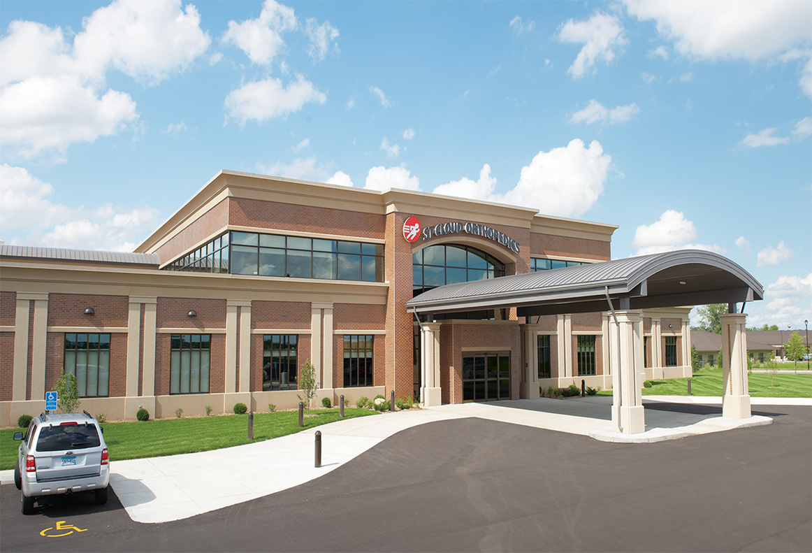
St. Cloud Orthopedics

Slide 8
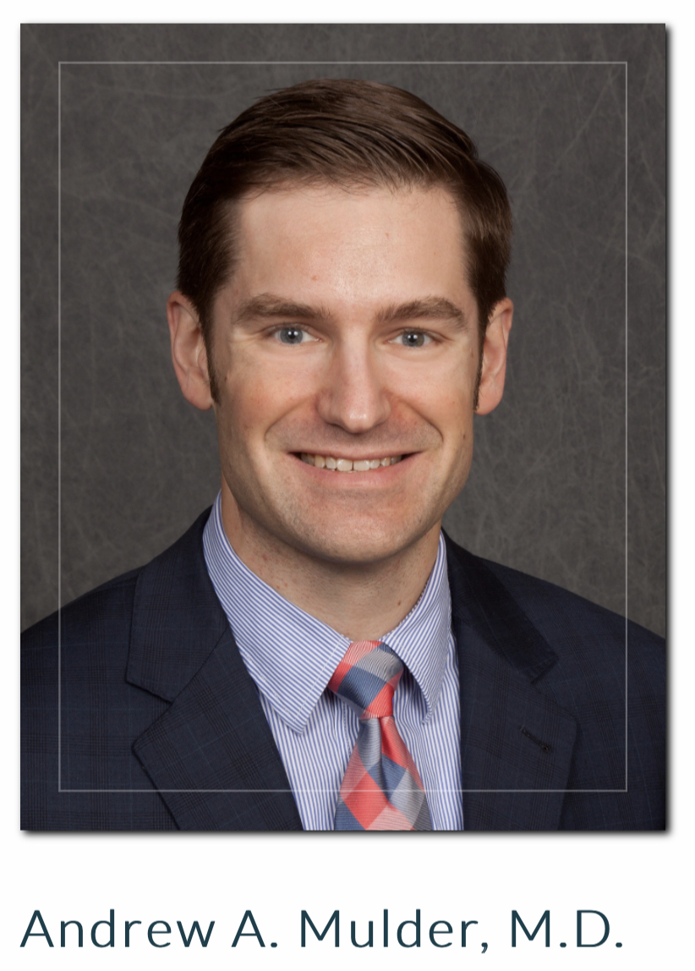
Who am I?
Orthopedic Residency 2007-12
Detroit Medical Center
Fellowship in total joints 2012-13
Cleveland Clinic
St. Cloud Orthopedics 2013-Present
No disclosures

Slide 9
Who Are The Surgeons?
St. Cloud Orthopedics was established in 1955 and continues as a physician-owned, private group providing specialty and sub-specialty care to most of central Minnesota.
Located approximately 70 miles from the Twin Cities of Minneapolis and St. Paul
2 clinic locations within the community with multiple surrounding outreach sites
22 physicians including 4 surgical podiatrists, one non-operative spine specialist and one family practice sports medicine physician
20 physician extenders - all surgeons with an assigned PA-C
Also own physical and occupational therapy and MRI services

Slide 10
Why do outpatient total joints?
Understand your community needs
We are a city and surrounding area of approximately 190,000
We have only one hospital within a 30-mile radius
We have one large health care system that includes a flagship hospital and 6 smaller community hospitals within approximately 60 miles
Limited access to services outside of this system without the capacity within those ORs to handle the volume of total joints our group was producing

Slide 11
Where to do Outpatient Total Joints?
Do you have access to facility that is convenient for providers and patients that is nimble, motivated and forward-thinking enough to accept the challenge?
Requires investment by many parties on multiple levels to be successful
Requires definite commitment and large amounts of time even before the first surgery is performed
Must be willing to adapt quickly and respond to challenges

Slide 12
Total Joint Program Evolution
What year did SCOA start joints in general?
2008 started a few total joints at SCSC but were not fully covered by insurance in an ASC
2012 meet with insurances to get payment on total joints, made progress, started BCBS bundle and other insurances followed with payment (non-bundled)
Late 2014 did first robotic total joint case at SCSC
All total joints in our center are done with robotics (knees, unis, hips)
Started doing limited number of cases/day. Now do 8-10/day.

Slide 13
Total Hip, Knee and Partial Joint Volume 2015-2022 (all robotics)
Medicare approved total knees 2019 and total hips 2021 to be done in ASCs

Slide 14
Robot Selection Process

Slide 15
Stryker Mako Robotic System

Slide 16
Why Mako?
We wanted better outcomes for patients
It forced us to plan and THINK about case before you cut!
We freely admit that everyone has outliers
Not all outliers fail, but in most circumstances outliers fail more often
Avoid complications with tools (eccentric reaming, incorrect COR, ream through pelvis, raising hip center)
Get the leg lengths right!
Didn’t like replacing compartments with minimal disease
Really balance a knee!!! - BEFORE MAKING CUTS
Admitting you’re not perfect

Slide 17
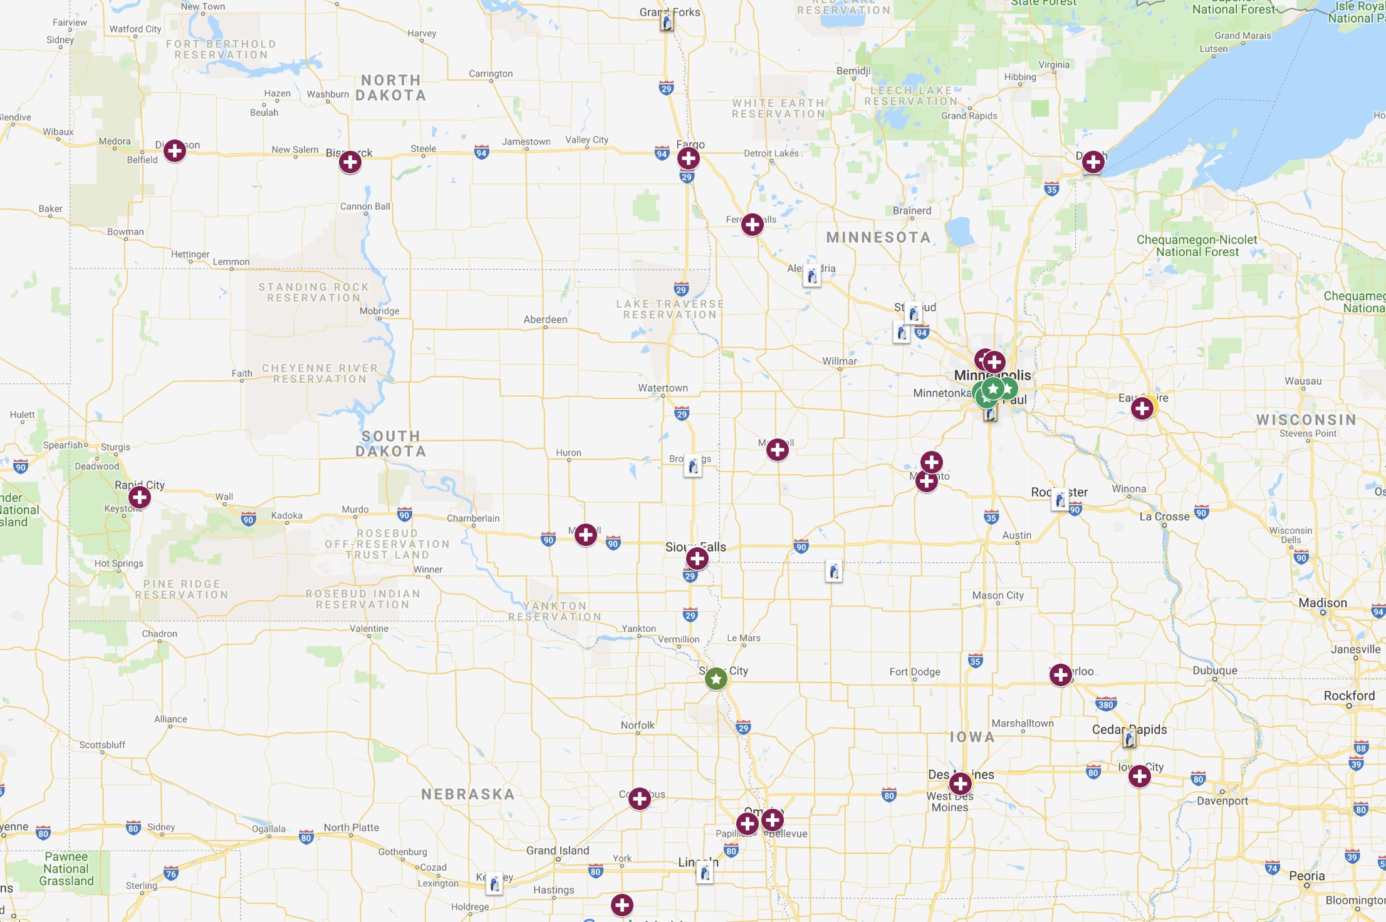
Existing Mako Sites
Altru
Essentia Virginia
CHI St. Alexius Dickinson
Essentia St. Mary’s (2)
Glendive
Welia Health
Lakewalk ASC (2)
St Cloud Surgery Center (3)
Alomere Health (2)
Allina Cambridge
St. Cloud Hospital (2)
Allina West Health ASC
Allina Buffalo
Oakleaf Surgical Hospital (2)
Avera St. Luke's Hospital
MN Valley Surgery Center
Black Hills Surgical Hospital (2)
Avera Brookings Health
Mayo Red Wing
River’s Edge Hospital
Sanford Health
Mayo Mankato
Mayo Rochester (2)
Avera Specialty Hospital
Avera Lakes Regional
Mayo Austin
Sioux Falls Specialty Hospital
Buena Vista Regional Medical Center
Sioux Center Health
Spencer Hospital
Waverly Health Center
Dunes Surgical Hospital
Columbus Community Hospital
St. Anthony Hospital
St. Luke’s
Broadlawns
Fillmore County Hospital
CHI Lakeside ASC
Mercy Medical Center (2)
Heartland ASC
Iowa Lutheran
KRMC
CHI Advanced ASC
CHI Kearney
Greater Regional Health
Lincoln Surgery Center

Slide 18
Mako Robot Benefits in Patient Outcomes
Mako TKA outcomes:
Shown to reduce soft tissue damage
Less pain
Less analgesia
Shorter length of stay
Reduced health source utilization and cost savings over 90 days
Mako THA outcomes:
Improved accuracy and high patient satisfaction
Direct anterior approach with Mako may also add benefit of the need for less fluoro which can reduce radiation exposure and be friendly to space constraints in an ASC by eliminating need for C-arm
Mako Uni-Knee outcomes:
Less pain
Less analgesia
Shorter length of stay
Implant survivorship better than manual in several studies and registry data and cost savings over 24 months

Slide 20
Implementation, Education, Infection Prevention, Outcomes

Slide 21
Equipment and Supplies
Meet with surgeons and get a list of equipment needed.
Use surgeon champions to get the cost of equipment and disposables at lowest possible price.
UV Light-Want to keep infections low-use UV light prior to the case opening and between each case.
Create preference cards
Total knee and hip packs
Streamline instrument trays
Changes since implementation:
One Tray, Condensing pans, Trials and Peel Packs

Slide 22
Creating a Joint Team
Started small with staff (4 techs for knees, 4 techs for hips)
Managing the instrument sets and implants, working with reps along with purchasing lead.
Techs familiarize themselves with instrumentation
Inservice on equipment new to this procedure
Dry run for all surgeons for all procedures to include surgical center staff, surgeon, PA, and rep.
Extra staff available for our first cases
Keep same staff doing cases until comfortable and then add in the next layer.

Slide 23
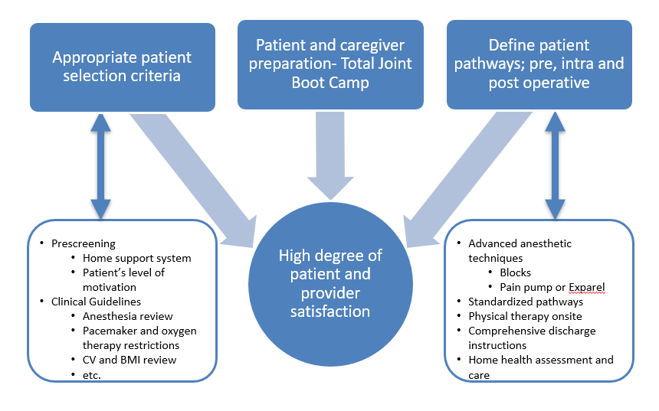
Patient In-Take Process

Slide 24
Patient Criteria
BMI 40> greater goes to anesthesia for review
No home O2 therapy
Any history of cerebrovascular/cardiovascular disease- to anesthesia for review.
Defibrillator patients are not candidate for total joint procedure in ASC
Severe systemic disease- review by MDA
Uncooperative, acutely agitated, dementia, delirium, frequent seizures not candidate
We will accept patients with controlled hypertension, controlled asthma, controlled seizures
Much stricter criteria when first started joints

Slide 25
Pre-Op Joint Education is Mandatory
Since Covid we now have a YouTube video our Joint Coordinator emails to all patients. They are expected to watch the video and then Coordinator calls each patient to answer questions.
Review Joint Book
Prepare patient to go home same day as surgery
Support person with them for first 3 days
Preparing their home:
Meals
Making sure walkways will accommodate a walker
Setting up a “base camp”
Assistive equipment- raised toilet seat, shower chair, walker etc.
Pre-hab appointment at St. Cloud Orthopedics

Slide 26
Post-Op Stay
Average stay post op approx. 4 hours
Discharged to home or skilled nursing facility (99% go home)
Discharge teaching and review
All patients walk prior to discharge
Practice with therapy stairs
PACU RNs trained by PT

Slide 27
Quality Measures
UV Light
Gel pad warmers-no forced air
Shorter OR time=decreased infection
Staff in the OR - stay in the OR, no in and out
Track our cases and outcomes

Slide 28
Pain and Infection Control Measures
PAIN CONTROL
Ofirmev
Oxycontin
Dexamethasone
Celebrex
Gabapentin
Pre-op peripheral nerve block for total knee patients
INFECTION CONTROL
Pre-op antibiotic
Pre-op scrubs at home and on admission
Iodine nasal swabs
UV light

Slide 29
Quality Metrics Total Joints 2015 to June 30, 2022

Slide 30
Business of Total Joints/Marketing

Slide 31
The Business of the Joint Program

Slide 32
Mako Vendor Relationship Benefits
Need to have strategic partnership from the start
Growth expectations
Implant pricing
Robot pricing and maintenance agreement
Marketing assistance where applicable
Physician leverage with vendor
As long as ASC sees the value in robots, the technology itself can be a driving differentiator in your business from the competition
Currently have 4 robots in our ASC, 3 of them are Makos

Slide 33
Marketing
Multifaceted Yearly Marketing Campaign
Patient Seminars
Social Media (Facebook, Instagram, Linked In)
Digital marketing
Web Site enhancements
Print media (special health or business publications)
Radio
Billboards
Targeted marketing – geographically more than 30 miles from center
WORD OF MOUTH some of best and cheapest marketing!!!

Slide 34
Billboard Campaign

Slide 35
Outpatient Surgery Magazine – August 2019

Slide 36
Website Marketing

Slide 37
Patient Testimonials

Slide 38
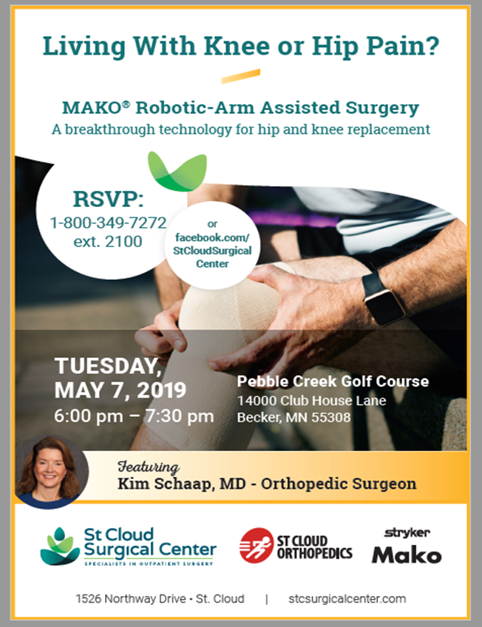
Patient Seminars

Slide 39
Final Words – Critical Success Factors

Slide 40
Robotics at TRIA Orthopedic Center

Slide 41
Megan Lauersdorf RN, BSN, CNOR
University of Wisconsin- Eau Claire
2010 B.S Kinesiology
2012 B.S Nursing
2017- Helped open TRIA Woodbury
Notes:
Allow me to introduce myself. My name is Megan Lauersdorf and I am the OR/SPD supervisor at TRIA Orthopedics. I hold bachelors degrees in Kinesiology and Nursing from the University of Wisconsin- Eau Claire. My journey with TRIA started back in 2017 where I was able to help open the ASC in Woodbury.

Slide 42
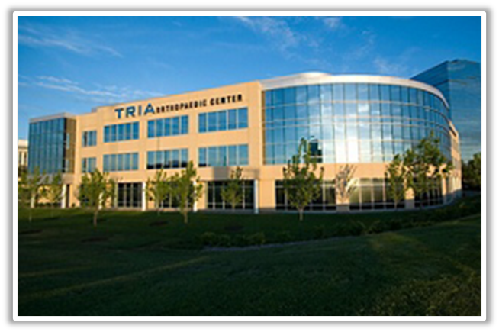
TRIA Background & Evolution
Notes:
TRIA was originally started in 2005. It started as a collaboration between Park Nicollet, the University of Minnesota, and the Orthopedic Center, a group of private practice physicians. The original concept was to create a program that would craft an exceptional experience for the patient that simultaneously would provide expert care. We wanted all our physicians to be fellowship trained to provide top level care, and to most importantly, to be patient centric.
In 2005, TRIA opened the first stand-alone full service orthopedic center here in the Midwest. We had all of our orthopedic services (clinic, imaging, physical therapy, and surgery) all in one location. Ultimately, this program expanded to the suburbs, with multiple locations opening between 2015 and 2021.

Slide 43
TRIA’s Services
Notes:
At each of our locations, we offer an urgent care, sub-specialty clinic appointments, and imaging. Physical therapy and hand therapy are on site. Two of our locations have orthopedic focused ambulatory surgery centers. The TRIA in Bloomington has 7 operating rooms, and the TRIA in Woodbury has 4 operating rooms. Our complete TRIA team includes over 100 physicians, 90+ therapists, and over 1250 supporting team members.

Slide 44
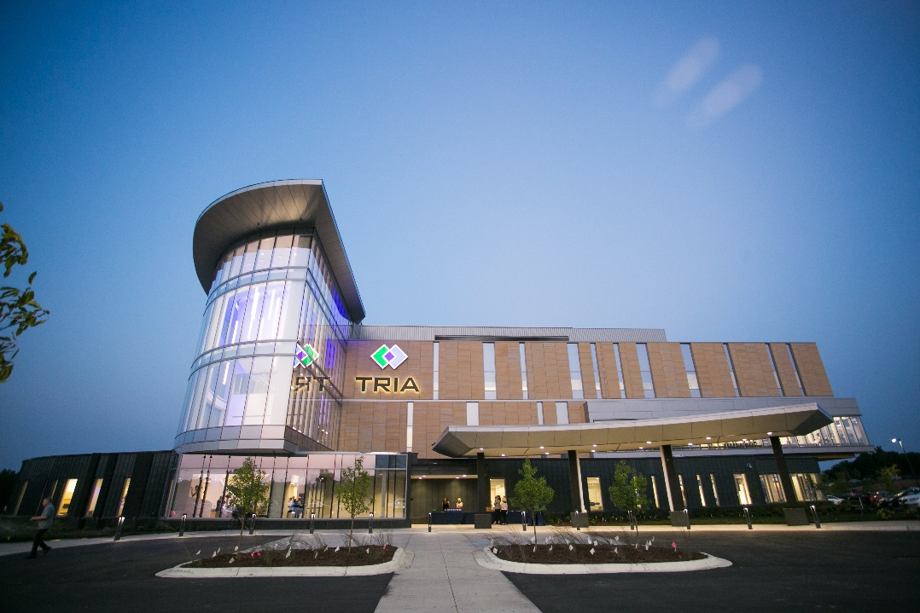
Academic Culture Fostering Innovation
Notes:
In addition to our clinical practice, we also participate in research and education. Many of our physicians are involved in fellowship education, and we also work closely with the University of MN residency program. Over the last 17 years, we have created a geriatric fracture network, pioneered the hotel recovery program, brought many outpatient hand procedures into the clinic setting, and in the last 5 years, have seen real growth in the outpatient discharge to home total joint arthroplasty.

Slide 45
Total Joint Program Evolution
Decrease total cost of care
Improve utilization of health care resources
Improve the patient experience
Improve quality of care
2008
Total and Uni Knees, Hotel Recovery Program
2010
Total Hips
2017
TRIA Woodbury opens with discharge to home and hotel recovery option
2018
Discharge to home at TRIA Bloomington
Notes:
When we started our outpatient total joint program, we had the vision of performing surgeries on healthy patients that did not need hospitalization. We wanted to focus on safety, and drafted anesthesia criteria for proper patient selection in an ASC setting. We created a total joint program focusing on decreasing the total cost of care, improved utilization of healthcare resources, improve the patient experience, and to improve the overall quality of care. We started in 2008 with total knees, and partial knees with the hotel recovery program, which then ultimately, evolved to include a discharge to home program.

Slide 46
Total Joint Volumes 2017-2022
Notes:
These are our total joint volumes from 2017-2022. We continue to see growth, and you can see how COVID-19 affected these numbers. Our limited hospital capacity during that time created the opportunity to increase our outpatient joint volume.

Slide 47
Criteria for ASC
Physician identifies patient as potential candidate
Nursing screens patient using criteria for ambulatory surgery
Review of health history, home support
Comorbidities and concerns require anesthesiology review for approval
Review program and requirements
Review plan of care and future appointments
Notes:
For a successful outpatient total joint program, we really need to start with patient identification in the clinic. Our surgeons are tasked to identify potential patients for outpatient surgery. Surgeon’s look at a patient’s ability, both physically and mentally to see if they are good candidates. Patient’s need to have the strength to move independently, and also have the emotional resilience to endure the stress of surgery as well as the post-op physical therapy. The patient’s are also assessed to see if they have any failing organ systems. If they have more than one failing organ system, they usually are not a candidate for outpatient surgery.
Once patients are identified in the clinic, they get a more detailed screening from our peri-operative nurses. Here the nurses really identify any additional potential barriers to outpatient surgery. If they have any concerns, our anesthesiologists will then review patient’s chart as needed.
We make sure to review the program with the patient’s so that they have a clear understanding of what to expect the days before and the days after the surgery. We also make sure that the patient has the appropriate post-operative clinic and physical therapy appointments set up prior to their surgery.

Slide 48
Pre-Surgery Care and Education
Patient screening, health history review, including MRSA screening
Nurse education session
Physical Therapy education session including gait training, exercises, upper extremity strength assessment, and car transfer
Total Joint guidebook, pre-surgery packet
Arrange a caregiver, their “personal coach”
Prepare home
Notes:
In terms of our pre-operative workup, the patient’s undergo initial physician and then nursing and possibly anesthesia screen. They all get MRSA swabbed. We have a 1:1 nurse education session instead of a “total joint camp”. All patient’s get a pre-operative physical therapy session where our therapists assess them for strength, and also instruct them on proper assist device usage and activities of daily living. One important aspect of the session is to go over car transfers, so they are ready at the time of discharge. The goal is to not have a patient learning a new skill immediately after a surgery. It all goes much smoother when they have had some practice at home.
Patient’s are also required to have a caregiver and/or a personal coach. This could be a close friend, or most likely a family member. This is an active process, not a passive one. The patients are encouraged to do the therapy, not have the therapy done to them.
Lastly, our patients are instructed to get their home ready. They make sure they have grab bars where they need them, banisters or railings on the stairways. They must have enough room to maneuver with a walker in their house. They should also get rid of all tripping hazards. If they can stay on one level, that is encouraged, but not required.

Slide 49
Infection Prevention
All total joint cases use chlorhexidine bath night before surgery and again in preop
MRSA /MSSA screening
Antimicrobial nasal swab preoperatively
Weight based antibiotic preoperatively
Patient pre-warming
Dilute betadine soak
Routine SSI surveillance for all joint cases 30 and 90 days
Woodbury air filtration system
Notes:
As a part of our program, we work hard to keep infection rates low. We send patients home with chlorohexidine soap for use before surgery. Again, everyone gets a MRSA screening. We weight base our peri-operative antibiotic regiment. We use a dilute intra-wound betadine soaking solution. We also have a laminar air flow system and positive pressure in the operating rooms.

Slide 50
TRIA ASC Infection Rates
Notes:
This is our infection rate for all cases done at our ASC. As you can see, we continue to trend downward.

Slide 51
Anesthesia/Pain Management
Spinal or TIVA
Periarticular block
Exparel
Joint cocktail
No femoral or adductor canal blocks
Multimodal medication plan includes Oxycodone, Celebrex or Mobic, Gabapentin, Tylenol
Notes:
For anesthesia, the patients have the option of a spinal or a TIVA anesthetic. We use local periarticular blocks. At this time, we have moved away from femoral and adductor canal blocks. Post-operatively, patient’s get a tailored pain management plan. This is constantly being optimized. They typically get scheduled Tylenol, a scheduled anti-inflammatory (Celebrex or meloxicam), hydroxyzine, a narcotic (tramadol, oxycodone, norco), and maybe gabapentin. All dosing is adjusted for age and kidney function.

Slide 52
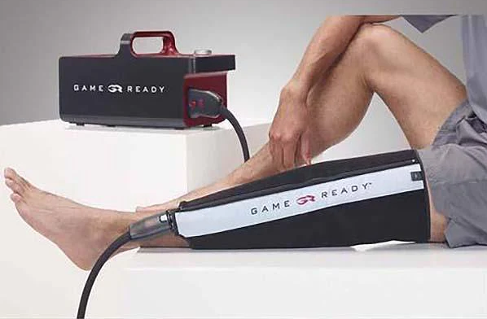
Post Op to Discharge
Pain management
Game Ready
Ambulate and urinate prior to d/c
Discharge education
Post discharge phone calls 1 day
Level of pain, ability to rest, nausea, questions on instructions
Post discharge call 7 days
Level of pain, ability to rest, nausea, post surgery how prepared did the patient feel they were to manage at home
24-hour nurse triage Careline
Notes:
Following the surgery, the focus is on pain management. We use the Game ready which is an icing and compression device. We make sure they are able to ambulate and urinate prior to discharge. Our average time for recovery including phase I and phase II is 3-4 hours.
We call patients the day after discharge and then again 7 days after discharge to evaluate their level of pain, their ability to rest, and their overall wellbeing. At anytime after surgery, the patients are able to call our 24 hour nurse triage careline with questions or concerns.

Slide 53
Average Pain Scores 1 Week Post-op
Notes:
Our 1 week post-op pain scores are in the 2-3 rage based off a 1-10 VAS(visual analog scale) scale (check with Mary)

Slide 54
2021 Hotel Recovery Satisfaction With Care, Ability to Rest and Absence of Nausea
Notes:
Our post-operative satisfaction rates are quite high, but we still have a small percentage of patient’s who experience post-operative nausea, typically because of anesthesia medications and narcotic medications. These results only indicate the presence of nausea not the severity.

Slide 55
2021 Discharge to Home Satisfaction With Care, Ability to Rest and Absence of Nausea
Notes:
Our discharge to home data mirror’s our hotel experience, with a very high level of overall patient satisfaction. Now I’ll turn it over to Dr. Huang to talk about how we got started with our robotic total joint program.

Slide 57
Dr Der-Chen Huang
2003 BS Biomedical Engineering, University of MN
2009 MD Dartmouth Medical School
2014 Residency University of MN
2015 Fellowship @ Joint Replacement Institute Los Angeles, CA
Dr. Thomas Schmalzried
Dr. Ed Mcpherson
2017 Healthpartners Regions
2018 TRIA Outpatient TJA
2022 1st Robotic TJA @ TRIA
Notes:
Thanks everyone for inviting me to speak this afternoon. It is my pleasure to be here. Here’s a little bit about my background. I have an undergraduate degree in biomedical engineering. I received my MD from Dartmouth Medical School, did my residency here in MN, and then did a fellowship in Total joint Arthroplasty in Los Angeles CA, under Dr. Thomas Schmalzried and Dr. Ed Mcpherson.
I joined Health partners in 2017, just before we opened the TRIA woodbury ASC. In 2018, I helped create the outpatient discharge to home program, and in 2022, I performed our first robotic assisted total knee arthroplasty at TRIA.

Slide 58
Surgeon Perspective
Surgeon champion
Exploration of robotics 2014
Review of technology offerings 2017
Bridge east and west side surgeons
Build consensus on robot selection
Notes:
So from my perspective, to really get a robotics program off the ground, you need a surgeon champion and nurse champions. If you don’t have an interested surgeon, you don’t have a program. We started looking into robotics in 2014, and really started reviewing the technology in 2017. One of our unique dynamics at TRIA is that we are a very large institution and we cover a large geographic area. We had surgeons in the west metro, who were not interested in robotics, and we had only a handful of surgeons on the east metro interested in building a robotics program. Because we are all operating within the same system, we had to sell this idea to our colleagues and involve them in the process. Within our organization, Dr. Paul Johnson from Methodist hospital had already been tasked with standardizing total joint pathways between the west metro and the east metro. At that time, the west metro had a very successful tried and true hotel program. While the east metro had started to push the envelope with a discharge straight to home program.
To get our surgeon colleagues interested, we had to create some excitement around robotics. We invited all the surgeons within our group to see the different robotic offerings available from various vendors. We invited our industry partners to bring in their unique systems for hands on experience and testing. Several of us went as far as to go visits other surgeons with well established robotics programs to see how they performed their surgeries and how they maintained their operating efficiency. (This included us visiting and observing Dr. Mulder’s group)
Once everyone had the opportunity to evaluate the different robotic systems, we ranked the robots as a group, and sent our recommendations to the administrative and purchasing department.

Slide 59
Why the Interest in Robotics
Precision/Consistency
Improving patient satisfaction
A necessary part of a comprehensive education program
Marketing Opportunity and Potential Volume Growth
It is the future
Notes:
Why am I interested in robotic surgery. These robotic assisted surgeries allow us to deliver a more precise and accurate joint replacement and decrease our surgical outliers. With this technology, we hope to decrease the number of patients who are unhappy with their knee replacements. I also serve as a clinical instructor with the Region trauma/arthroplasty fellowship and I believe robotics is part of a comprehensive educational program. Another important aspect of robotic assisted surgery is that we have the opportunity to use this technology to increase our local market share. I also truly believe that this is the future of joint replacement surgery. Just like how collision alert and lane assist technology has enhanced the driving experience, robotics will ultimately enhance the surgical experience.

Slide 60
Key Attributes of a System
Simple and accurate pre-operative planning
Efficiently setup in surgery (doesn’t add a lot of time) and easy for all in the OR to use
Easily adjusted/used
Strong support technicians who know surgeon preferences
Low front-end patient cost for requisite imaging
Not a lot of cost add from a disposable/reusable standpoint
Willingness to pay more for ‘proven’ outcomes/accuracy
Easily portable – can move between locations
Both hip and knee software
Notes:
So as we were looking at the different robotics systems, we did have several metrics in mind. As you know, surgeons do not do the same surgeries in the same manner. Technique varies, and we all think our way is the best way. As we were choosing a robotics system, we wanted to make sure that individual surgical work flow was not adversely affected. The system had to be able to adapt to multiple surgical techniques. We also wanted the system to be easy to setup, and easy to use. Also, we had to be able to do this without breaking the bank.

Slide 61
Robot Selection Factors
Rapidly advancing technology, strong interest from key surgeons
Vendor demonstrations
Surgeon cadaver labs
Cost per case, cost of disposables, cost of additional imaging- x-ray/CT, annual service fees
How will robotics fit into our teaching programs
myVoice survey for consumer awareness/interest in robotic assisted surgery
Notes:
When we started looking at this technology in 2017, the robotics systems were rapidly advancing. New software and hardware advances were being made every year. Our key surgeons evaluated the re-evaluated the different systems as they evolved. In 2021, we rolled out the evaluations to all the surgeons within the TRIA system. Once the surgeons gave their opinions on their preferred robotic system, the administration and purchasing department then looked the over cost of care and how this would impact our total joint bundle as well as our bottom line. As part of this process, we also reached out to our patients and asked them what they thought robotic surgery was all about.

Slide 62
myVoice Patient Survey - What is Robotic Assisted Surgery?
Dr working joysticks to help surgery
A surgeon operates a controller that performs the actual surgical tasks rather than the surgeon's own hands.
Surgery using a robotic tool to help the surgeon do accurate and delicate actions
Surgery done by a robot or by technology, not a person
A robot controlled by a doctor operates on you
Using technology to help a surgeon be even more precise with whatever the procedure is.
Surgeon guides the arms/tools of a device to perform the surgery.
Remote surgeon.
Notes:
Our patient survey responses ranged from robot assisting the surgeon, a surgeon performing the surgery remotely, to the robot doing the surgery independently. It turns out patients are not yet knowledgeable on this topic.

Slide 63
Implementation
Certification for robotics
“Learning curve”
Considerations for scheduling cases
Initially add time
Limit case numbers at first
Notes:
Once we selected our robotics platform, all interested surgeons were required to undergo certification to use the robot. Each company has their own training program, and the surgeons need to be familiar with both the software and the hardware to execute the surgery well. There is a definitely a learning curve. Most surgeons will take somewhere between 10-50 cases to become time neutral. In regards to case scheduling, we took this into account and built in additional time for the surgeon and surgical staff to learn the robotics system.

Slide 64
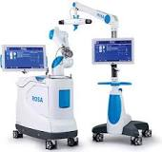
Robotics
Arrived to TRIA sites December 27, 2021
Implementation plan developed
Team member apprehension
Surgeon excitement
Go slow to go fast philosophy
Notes:
Once purchased, our robotic system arrived very quickly at the end of 2021. Implementation into the operating rooms began rapidly.
As with anything new, there is always apprehension and reservation, but as the surgeons became excited about the technology, the team members were eager to perform the first case. Our philosophy was to start slow. If we started slow, we can make the process smooth, and if everything goes smoothly, then we can go fast.

Slide 65
Operating Room Planning
Name the robot contest
Preference cards created
Verified IFU’s
Added to Lawson, IBS
Ensured instrument sets are the same for both sites
Guidelines for scheduling cases developed
Notes:
We also needed to create new surgery preference cards for robotic surgery. We verified our instructions for use to ensure instrumentation was safe for patient use. We add our implants and consumables into our supply chain system. We standardized instruments sets for both sites, and developed guidelines for case scheduling. This was only a small portion of the behind the scenes house-keeping tasks that needed to be done. We also had a fun name the robot contest to increase staff interest.

Slide 66
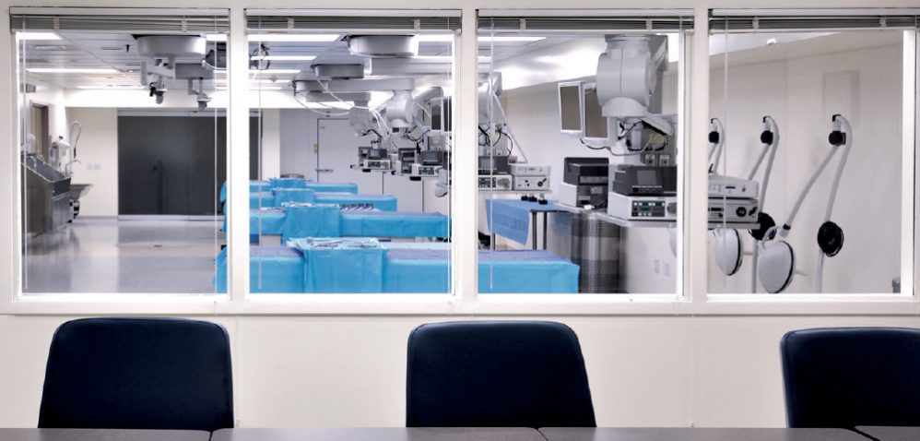
Education
Team education
All ASC Team meetings across sites
Surgeon, PA bio skills lab education and certification
Hands on bio skills lab for surgical techs
Dry Run/Mock surgery with Team
Imaging team education
Limb length x-ray, positioning tracker
Notes:
As part of this slow is smooth and smooth is fast philosophy, we educated all of our teams across both ASC’s. We hosted several bioskills labs for the surgeon and their teams to become familiar with the systems. We did the same for our surgical techs. We also had a mock surgery the night before our first case to essentially have a dry run with the robot to ensure that everything would go smoothly.
Outside of surgery, we also had to work with our imaging department so that they could learn how to take the appropriate XRs for our robotic system. We also created additional privileges for robotics as a part of our credentialing process.

Slide 67
Dry Run for Surgery
Draping robot
Saw bones
Dry run through the entire robotics procedure
Notes:
This is a picture from our dry run. We had our techs practice draping the robot the night before our first case, and had the surgical team practice with saw bones in the operating room with all the instrumentation to ensure that everything would go smoothly.

Slide 68
Program Progression
Performing cases since March 2022
Started with a surgeon per site
Currently 6 surgeons performing cases, with 3 more scheduling future cases
Early and late adopters
Notes:
Once everything was in place, we performed our first robotics case March of this year. We started with one surgeon on the west side and one surgeon on the east side. This was largely done to work out any remaining kinks in the system. Due to the preparation done before hand, the execution went smoothy. I would say within the group, we now have 6 surgeons already proficient with robotics, and another 3 starting on their robotics journey.

Slide 69
Patient Experience
Infection rate
Hospital transfer rate
No surgical revisions
Patient satisfaction 99.5% highly satisfied/satisfied
Direct to home or hotel option
Hotel provides hospitality
TRIA provides expert medical and nursing care
Notes:
At this time, we have not broken out our data specific to robotics, but we have not noticed any change in infection rate, hospital transfer rate or revision rate. Patient satisfaction remains high, and this has not had any effect on our home or hotel program discharge options.

Slide 70
Early Robotic Outcomes
Patients anecdotally reporting less pain
We anticipate less pain, earlier activity, decreased manipulation rate, and an increase in satisfaction scores
Outcomes?
Notes:
At this time, our early robotics experience has been pretty positive. Anecdotally, our patient’s are reporting less pain, and seem to have better post-operative motion. We do not have any outcomes data as of yet, but we are collecting it prospectively.

Slide 71
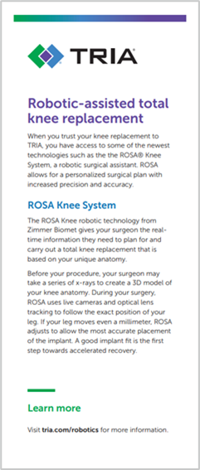
Marketing
Digital banner ads
SEM ads
Social media posts
Clinic monitor
Stick card
Seminar slide
LinkedIn ads (B2B)
Notes:
Once we’ve proven to ourselves that this is doable and a course that we want to continue pursuing; we then involved our marketing department. They started working on digital banner ads, search engine marketing ads, social medial posts, and using our large clinic monitors to display advertisement information. We also created stick cards or basically pocket-sized information cards for the program at TRIA. Our marketing department also started working on business 2 business and business to consumer ads.

Slide 72
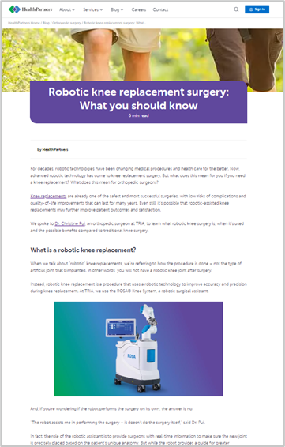
Web
New landing page
TRIA Blog
Notes:
As part of this process, we also created a new web page with a brief explanation to educate patients on the technology, as well as adding some information to our main websites and blogs.

Slide 73
Frances’ knee replacement story
Frances, who’s 74, lived with knee pain for about 10 years. But when she couldn’t walk for more than a few minutes, she made an appointment with Dr. Pui and they decided the best thing was a knee replacement – with the help of the robotic assistant.
Frances was a little worried about the recovery process. She thought it would take a long time to get back to normal activities and that she would be in pain.
But that wasn’t Frances’ experience. Instead, when she woke up after her knee replacement procedure, she was hardly in any pain. After 3-4 days she stopped taking the pain medication except at night.
She was much more mobile more quickly than anyone would have expected. “When I would walk into places they were like, ‘Really you just had it done a week ago?’” said Frances.
She’s happy that she had a robotic-assisted knee replacement surgery and knows that her doctor is a huge part of her success.
“Every time I hear horror stories about the pain, I just want to find Dr. Pui and give her a hug,” said Frances.
Notes:
We also included patient testimonials. This particular patient had a wonderful robotic experience and was extremely satisfied with her surgeon.

Slide 74
PRESS RELEASE October 4, 2022
BLOOMINGTON, Minn. — TRIA Orthopedics continues its commitment to excellent care and innovation with the use of ROSA Knee System from Zimmer Biomet, a new-to-the-market robotic surgical assistant used for total knee replacement surgery.
ROSA Knee starts with a series of X-rays of the patient’s knee. Those X-rays are used to create a 3D model, which allows the surgeon to tailor the surgery to the anatomy of each patient. While the sample size is small, ROSA knee allows the surgeon to make more precise cuts to the bone, which can potentially lead to faster increases in range of motion, quicker recovery and a greater chance for long-term success.
“We’ve been waiting for robotic technology to get to the point where it makes sense for our patients – and now it has,” says Der-Chen Huang, MD, an orthopedic surgeon at TRIA and co-physician leader of robot-assisted total knee replacements. “By investing in this technology, we are able to offer a state-of-the-art solution to optimize patient outcomes.”

Slide 75
Next Steps
Total hip robotic assisted surgery
Marketing campaign ramp up
Outcomes
Notes:
As of right now, we have only performed robotic total knee replacements. Our next step with the robot is to start our planning process for robotic assisted total hip replacements. We are also going to start rolling out our marketing directives, and we will continue to gather data on our outcomes to ensure we are providing high quality care.

Slide 76
Keys to a Successful Program
Physician and nurse champion
Clear screening protocol and criteria
Partner with patients and personal coach
Importance of prehab
Focus on patient education, patient safety, patient preparedness
Notes:
In summary, the key to developing a successful robotics program, starts with a surgeon and nurse champion to push the idea, and an administration that is willing to engage in the process. Do not underestimate the amount of time it takes to evaluate and select a robotics platform. Planning and implementation needs to be thoughtful and inclusive of all team members. Go slow to go fast.
In regards to outpatient surgery, the patient selection process is very important. You need to have a good screening process and criteria established for the ASC. There is a lot more front-end education and question answering to set up patients for success. It is important that the patients have a coach. We encourage them to work on their pre-hab exercises, practice transfers and walking with assist devices all prior to the surgery so that they are not learning a new skill in the immediate post-op period. If you focus on patient education, patient safety, and patient preparedness, you will be setting your program up for success. Thank you.

