Slide 1
Nurse Anesthesia History
Leah Gordon, DNP, APRN, CRNA

Slide 2
Anesthesia providers in the USA:
CRNA (Certified Registered Nurse Anesthetist)
CRNA Fellow
SRNA (student nurse anesthetist) Resident Nurse Anesthesiologist
Physician anesthesiologist
Physician anesthesiologist resident or fellow
Anesthesia Assistant (AA) NOT a Physician Assistant with more training
Notes:
Sedaysys machine

Slide 3
Anesthesia Providers
Medical Doctors of Anesthesia (MDAs) are physicians whom after medical school (medicine or osteopathy) complete one year internship (first year of residency) and two additional years of residency in anesthesia
4 year bachelor degree
4 years of medical school with special experiences
3 years of residency training
Option to be board certified. Not mandatory

Slide 4
Anesthesia Providers: CRNAs
4 year degree, preferably in nursing
At least 1 year experience in a critical care setting
Highly competitive to gain admittance to school
Program is rigorous:
Over 2500 hours of clinical time (1.5 – 2.5 years of bedside care)
40 hour school/ clinical week

Slide 5
Anesthesia Providers: CRNAs
Doctoral degree
All medical specialties switched well before nursing including pharmacy, occupational therapy, physical therapy, etc.
2025 all CRNA programs are now Doctorate as a terminal degree

Slide 6
Anesthesia Providers: AA’S
Anesthesiologist Assistants complete a 4 year undergrad degree & satisfactorily complete an anesthesiologists assistant education program
AA’s are licensed in 21 states:
Cannot practice without a physician collaboration, generally that model is 2:1
Not a Physician Assistant with additional training

Slide 7
What is a CRNA?
Certified Registered Nurse Anesthetists (CRNAs) have been providing anesthesia care to patients in the United States for more than 150 years.
Induce, monitor, and awaken patients during all surgical procedures
Primary bedside caregiver
Work in an independent or collaborative practice with physician anesthesiologists
Generally enjoy a high degree of autonomy and professional respect.

Slide 8
What can CRNAs do?
Thoroughly assess patients prior to an anesthetic and clear them for the procedure
Determine a complete anesthetic plan
Deliver the anesthetic
Direct care for the patient throughout the recovery process.
Notes:
We are responsible for the patient throughout the entire footprint of procedure care.

Slide 9
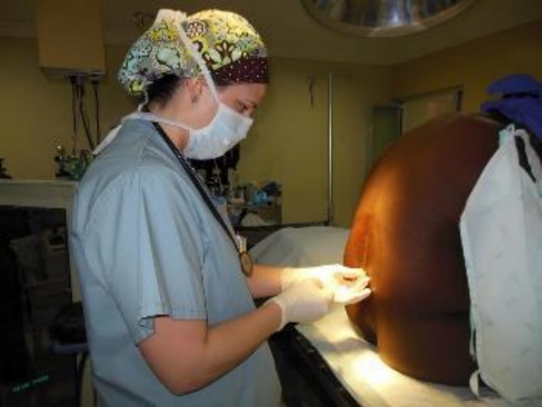
What do CRNAs do?
Provide all levels of anesthesia care including pain blocks, epidurals, spinals
Intubate and manage airways in all circumstances
Place central lines and arterial lines, start IVs
Respond to all code situations in hospitals, and are often the code leaders

Slide 10
What is the difference between a CRNA and AA
CRNAs are trained to work with or without physician involvement
Autonomous
AA’s are Dependent providers
Must take delegated orders from an anesthesiologist
Notes:
What is the difference between a CRNA and an AA?
CRNAs are educated and trained to work with or without physician involvement and are capable of high-level AUTONOMOUS function and judgement. AAs are DEPENDENT providers who can only take delegated orders from an anesthesiologist.

Slide 11
Licensed & Certified/ Continuing Education
CRNAs are licensed in all 50 states
2 licenses are required in the state of Minnesota:
APRN license issued by the board of nursing
Registered Nurse license issued by the board of nursing
National Board of Certification and Recertification
Must meet their standards every 2 years
New CPC program including specific modules, a written exam, and skills performance

Slide 12
Full Practice Authority in Minnesota
The bill was introduced in 2013-2014 and was pulled due to the lightning rod of pain management and CRNAs.
Resubmitted the bill and it was passed into law in 2015.
Much of this was due to the work that all of the APRNs in the state did to connect with local lawmakers on both sides of the aisle to get support and bring the bill to law.

Slide 13
Full Practice Authority
Full practice authority passed in 2015, with the stipulation that CRNAs must have a collaborative agreement to practice in pain with a physician.

