Slide 1
QUALITY Improvement Studies Best Practices, Strategies & Tools for Tracking Data and Better Patient Outcomes
Hailey Englund – Lead ASC Quality Program Manager

Slide 2
Post-operative phone calls
Patient satisfaction - “Staff Concern During Follow Up Call” indicator
Noted trend of declining score
Free text comments expressing dissatisfaction with the perceived concern and care of staff
Implemented a second post-operative phone call for identified patients
Education provided to pre/post RNs regarding the second call process prior to implementation
MNASCA | QUALITY Improvement Studies: Best Practices, Strategies & Tools for Tracking Data and Better Patient Outcomes

Slide 3
Post-operative phone calls - RESULTS
Goal – 92.5
MNASCA | QUALITY Improvement Studies: Best Practices, Strategies & Tools for Tracking Data and Better Patient Outcomes

Slide 4
LOCAL ANESTHESIA DOSING
Occurrence report submitted indicating suspected incorrect dose of local anesthesia based on patient body weight
No specific protocol, process or dosing parameters related to local anesthetic dosing
Collaborated with Anesthesia to create max local dosing communication tool
Education provided to staff regarding tool and tool implemented
Educated staff to additional resource – Safe Local app
MNASCA | QUALITY Improvement Studies: Best Practices, Strategies & Tools for Tracking Data and Better Patient Outcomes

Slide 5
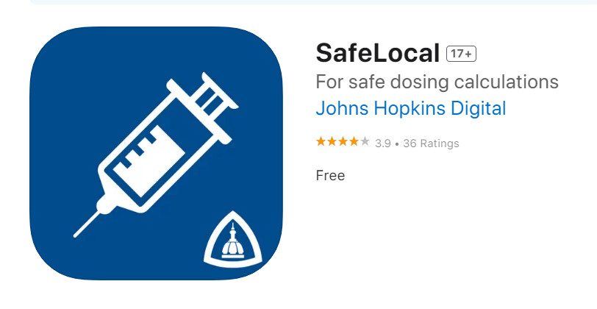
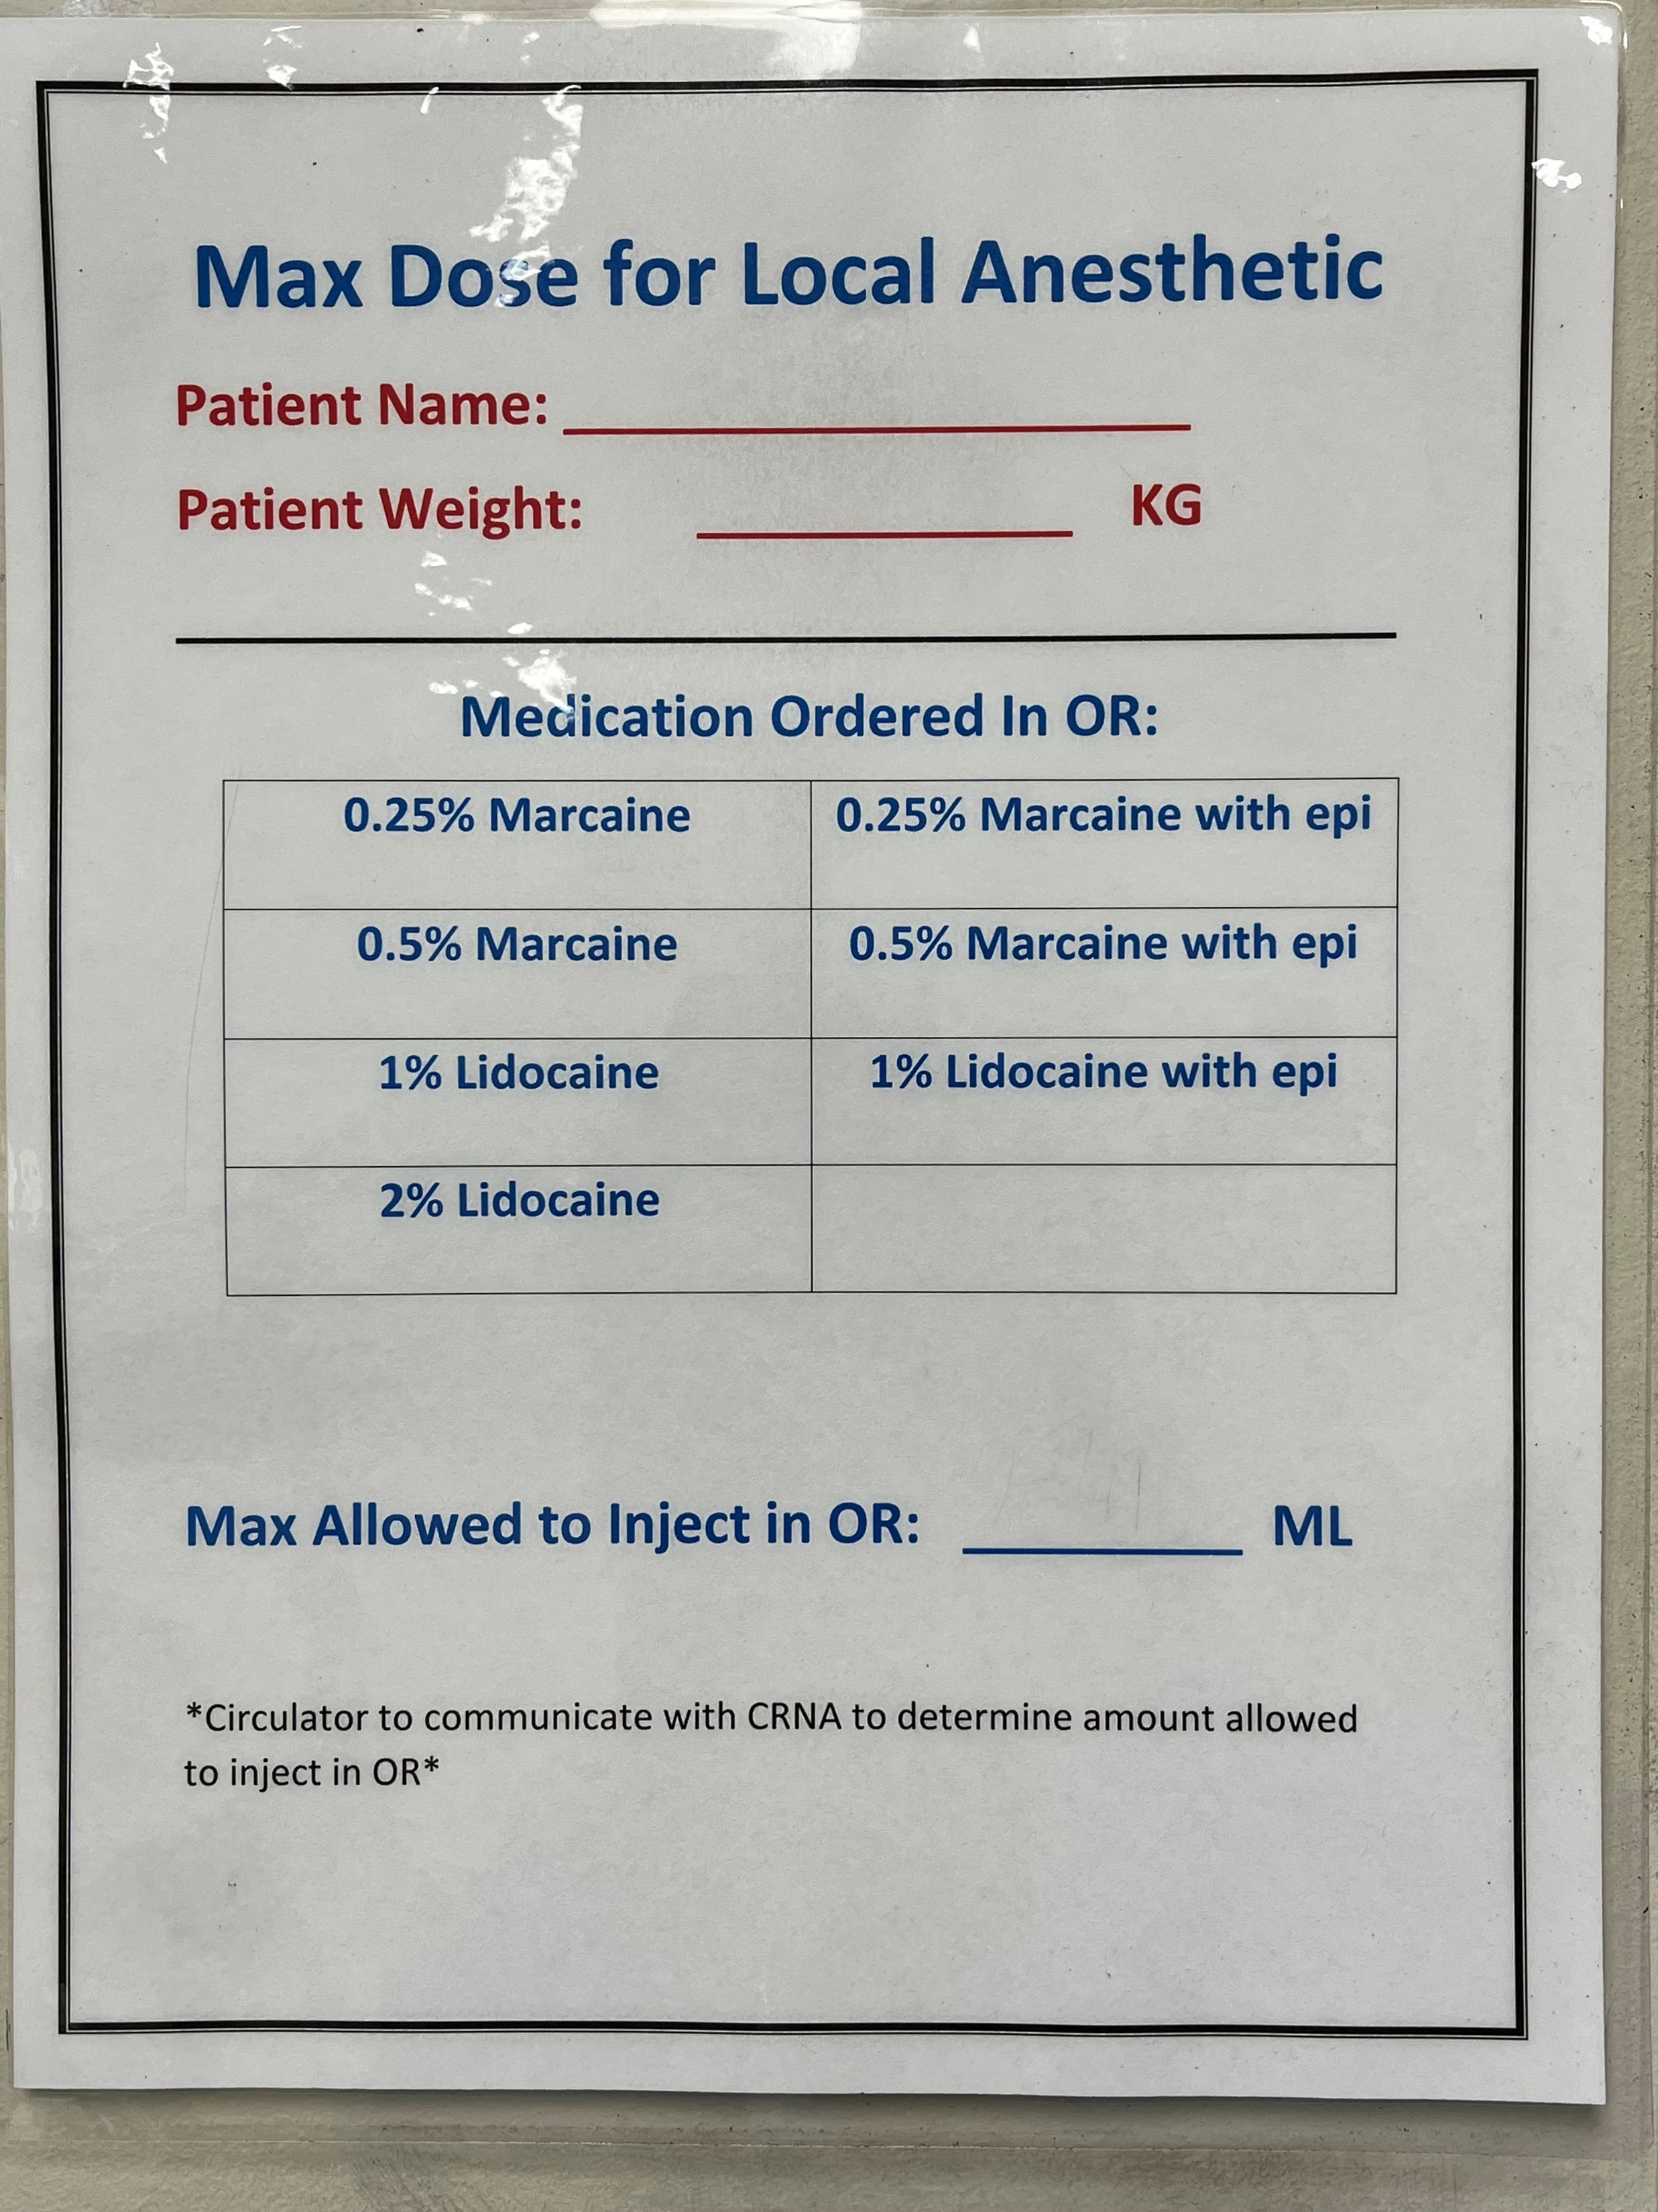
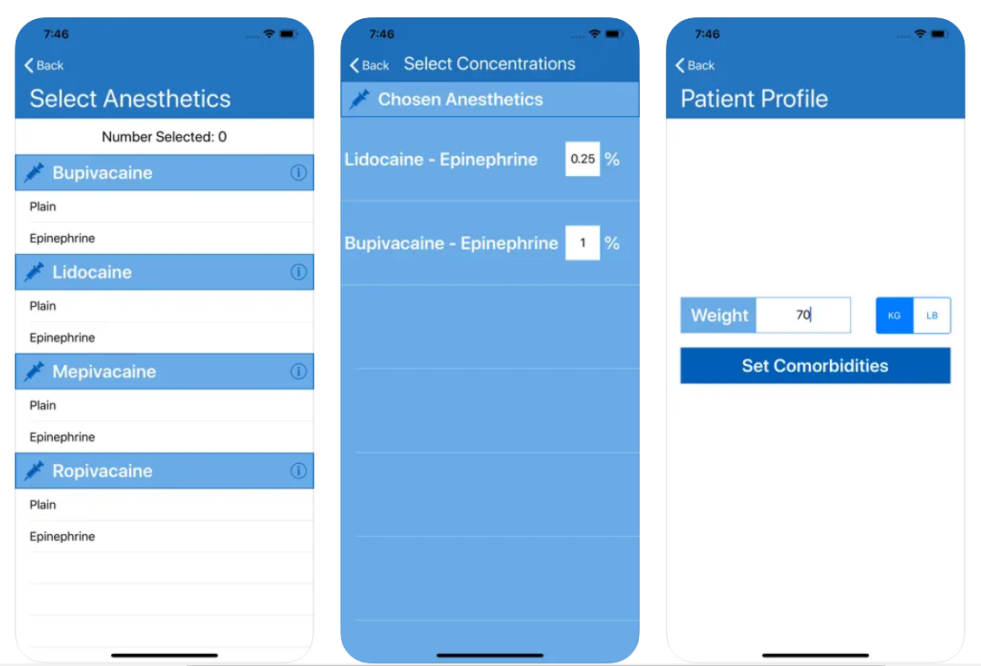
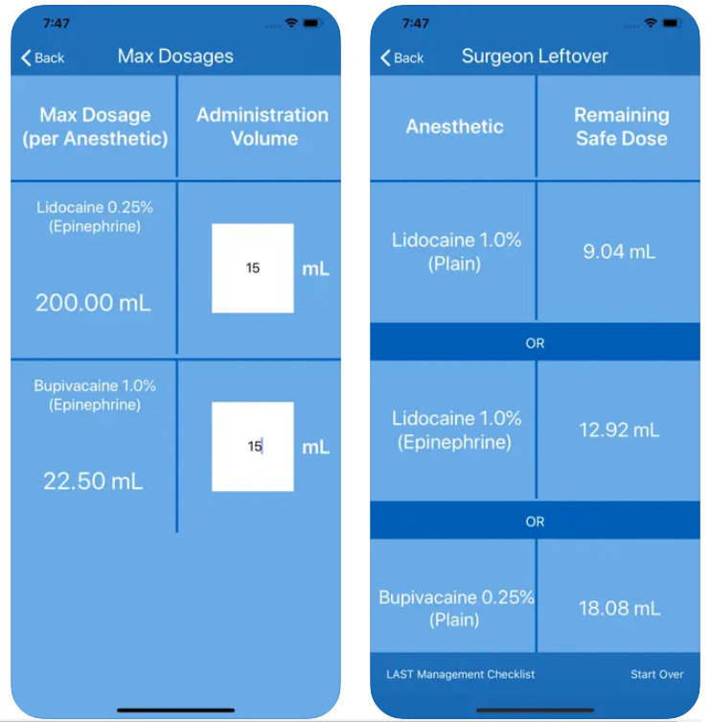
LOCAL ANESTHESIA DOSING - TOOLS
MNASCA | QUALITY Improvement Studies: Best Practices, Strategies & Tools for Tracking Data and Better Patient Outcomes

Slide 6
LOCAL ANESTHESIA DOSING - RESULTS
Tool Utilization Audit
30 completed over 2-month time span
Goal: 90% compliance to utilizing tool
Result: 93.3% utilization
Medical Record Documentation Audit – patient received appropriate dose based on kg
10 completed over 2-month time span
Goal: 100%
Result: 100%
No additional occurrences related to local dosing
MNASCA | QUALITY Improvement Studies: Best Practices, Strategies & Tools for Tracking Data and Better Patient Outcomes

