Slide 1
ASC Quality Reporting (ASCQR) Program
(ASCQR) Program is a CMS pay-for-reporting program which collects and publicly reports facility-level quality measure data.
ASC-1: Patient Burn
ASC-2: Patient Fall
ASC-3: Wrong Site/Side/Patient/Procedure/Implant
ASC-4: All-Cause Hospital Transfer/Admission

Slide 2
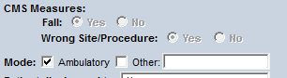
Process Focused Evaluation
ASC-1 Burn
ASC-2 Fall AND ASC-3 Wrong Site/Procedure
Skin Assessment
Burn vs irritation from adhesive
Documentation (location & method)
Training

