Slide 1


Drug Testing and Reasonable Suspicion under Minnesota’s New Marijuana Laws
Oct. 5, 2023

Slide 2





Slide 3
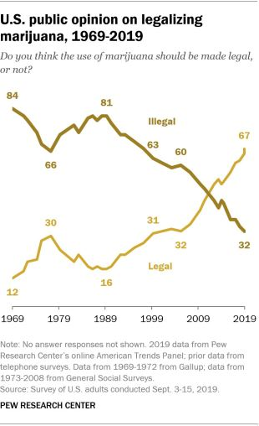

Slide 4
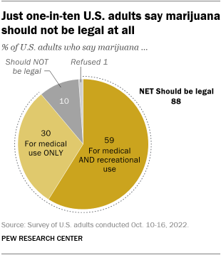

Slide 5
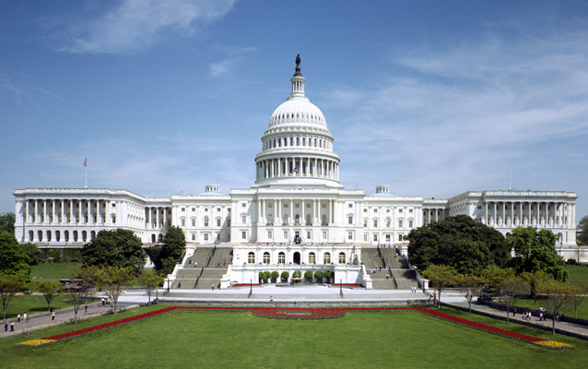
Marijuana under Federal Law

Slide 6
Marijuana under Federal Law
    The Controlled Substances Act (CSA), 21 U.S.C. § 811 classifies marijuana (cannabis) as a Schedule I Drug, which means that the federal government views marijuana as “highly addictive” and “having no medical value.”
    Schedule I Drugs
      Heroin, lysergic acid diethylamide (LSD), marijuana (cannabis), methylenedioxymethamphetamine (ecstasy), methaqualone, and peyote.
    Schedule II Drugs
      Vicodin, cocaine, methamphetamine, methadone, hydromorphone (Dilaudid), meperidine (Demerol), oxycodone (OxyContin), fentanyl, Dexedrine, Adderall, and Ritalin

Slide 7
Federal Law (cont.)
    “Marihuana” and “marijuana” is defined to mean:
      “All parts of the plant Cannabis sativa L., whether growing or not; the seeds thereof; the resin extracted from any part of such plant; and every compound, manufacture, salt, derivative, mixture, or preparation of such plant, its seeds or resin.” 21 U.S.C § 802(16)(A).

Slide 8
“Hemp” Is Not “Marijuana”
    2018 Farm Act, Pub. L. No. 115-334, 1
      Removes “hemp” from the definition of “marijuana” in the CSA
      “Hemp” is defined to mean “the plant Cannabis sativa L. and any part of that plant, including the seeds thereof and all derivatives, extracts, cannabinoids, isomers, acids, salts, and salts of isomers, whether growing or not, with a delta-9 tetrahydrocannabinol concentration of not more than 0.3 percent on a dry weight basis.” 7 U.S.C. § 1639o(1).

Slide 9
“Hemp” Is Not “Marijuana” (cont.)
    “Hemp” Is Lawful
      In AK Futures LLC v. Boyd Street Distro, LLC, 35 F.4th 682 (9th Cir. 2022), the Ninth Circuit held that an e-cigarette maker could enforce its trademark because its hemp-derived products were now lawful under the Farm Act.
    Products that are “hemp” (and not “marijuana”) are not disqualified from federal protection.
      What about seeds?
      What about products containing Delta-8?

Slide 10
New CSA “Schedule” for Cannabis?
    On August 29, 2023, HHS recommended marijuana be rescheduled under the CSA from a Schedule I controlled substance to Schedule III controlled substance.
    Under the CSA, HHS’ recommendations “shall be binding . . . as to [] scientific and medical matters.”
    The DEA still would have to engage in formal rulemaking process (with notice and comment period) before any new schedule could take effect.

Slide 11
New “Schedule”? (cont.)
    What would change?
      Section 280E would go away.
      Cannabis businesses would be able to claim business deductions.
    What would not change?
      Cannabis will not be federally legal.
      Cannabis will not become legal in states that do not authorize medical and adult use licensed cannabis businesses.
      Interstate commerce in cannabis will not be legal.

Slide 12
The Drug Free Workplace Act
    The Drug-Free Workplace Act applies to employers who receive a federal contract of at least $100,000 and employers receiving a federal grant of any size
    DFWA does not require employers to conduct drug or alcohol testing
    DFWA does require covered contractors to implement a “Drug-Free Workplace Policy.”

Slide 13
Federal Drug Testing
    The U.S. Department of Transportation (DOT) requires drug and alcohol testing of employees in various transportation industries, including industries regulated by the Federal Aviation, Railroad, Transportation, and Highway Administrations.
    DOT regulations require covered employers to conduct the following types of tests of employees covered by the DOT regulations:
      Pre-employment testing (49 C.F.R. § 382.301)—This includes testing an employee prior to the first time they perform a covered duty, for example, if an employee transfers into a different position.
      Post-accident testing (49 C.F.R. § 382.303)—Following an accident, covered employees must be tested “as soon as practicable.”

Slide 14
Federal Drug Testing (cont.)
    DOT drug testing (cont.):
      Random testing (49 C.F.R. § 382.305)—Employers must conduct random alcohol testing of at least 10 percent of its covered employees annually, and conduct drug testing on at least 25 percent of covered positions.
      Reasonable Suspicion (49 C.F.R. § 382.307)—Employers must conduct testing when the employer has a reasonable suspicion the employee has violated the employer’s prohibition on drug and alcohol use/intoxication during work.
      Return-to-Duty (49 C.F.R. § 382.309)
      Follow-Up Testing (49 C.F.R. § 382.31)
    DOT regulations expressly preempt State or local law (49 C.F.R. § 382.109).

Slide 15

MN-DATWA

Slide 16
MN DATWA – Who is Covered
    Minn. Stat. §§ 181.950-.957:
      The law applies to all employers.
      It covers all employees, including independent contractors.
      Job applicants are also protected.
        A job applicant is defined as any person who has applied for work with an employer and anyone who has a job offer contingent upon passing a drug or alcohol test.

Slide 17
Employer Requirements:
    Testing can only be done under an employer’s written policy, which must include the following:
      Who is subject to testing under the policy and when testing is required;
      The disciplinary consequences of a positive test result;
      The employee’s right to refuse testing and the consequences of refusal; and
      The employee’s right to explain a positive result and to take a re-test.

Slide 18
Employer Requirements: (cont.)
    Prior to testing, the employer must provide the written testing policy and a form to acknowledge receipt of the policy to the affected employee.
    Notice of the policy must be posted in an “appropriate and conspicuous” location. The notice must state that employees can inspect the policy during regular work hours.

Slide 19
Employers’ Requirements (Testing)
    An employer must use an accredited or licensed testing laboratory to conduct the testing.
    The test results, with few exceptions, are confidential information which the employer may not disclose without the employee’s written consent.

Slide 20
When is Drug Testing Allowed?
    Job Applicant Testing
      After an employee has received a conditional job offer, the employer may require or ask that the applicant undergo drug testing.
      This applies only if all applicants who receive conditional job offers for the same position are required or asked to undergo testing.

Slide 21
When is Drug Testing Allowed?
    Routine Physical Examination Testing
      An employer may require employees to take a test as part of a routine physical examination.
      The physical and drug test can only be required once annually.
      The employee must be given at least two weeks' written notice of the testing requirement.

Slide 22
When is Drug Testing Allowed?
    Random Testing
      An employer may require random drug testing only if:
        An employee is in a “safety-sensitive position,” defined by statute as a job in which an impairment caused by drug or alcohol usage would threaten the safety or health of any person; or
        The employee is a professional athlete and the testing is conducted in accordance with a collective bargaining agreement.

Slide 23
When is Drug Testing Allowed?
    Reasonable Suspicion Testing
      An employer may require testing if there is a “reasonable suspicion” that the employee:
        is under the influence of drugs or alcohol;
        has violated written work rules regarding drugs or alcohol; or
        has caused a personal injury or a work-related accident or was involved in operating machinery involved in a work-related accident.

Slide 24
When is Drug Testing Allowed?
    Treatment Program Testing
      An employer may require an employee to undergo testing if the employee (1) has been referred by the employer for chemical dependency treatment or evaluation; or (2) is participating in a treatment program under an employee benefit plan.
      In such cases, the employee may be required to undergo drug or alcohol testing without prior notice during the evaluation or treatment period and for up to 2 years after treatment.

Slide 25
DATWA: Employer’s Limitations
    Employees who fail a drug or alcohol test are entitled to significant protections even after testing positive.
    The employer must give written notice of a test result to an employee within three workdays of the employer’s receipt of the result.
    After an initial positive screen, the employee must be notified of the right to explain the result, and to disclose any medications taken that could affect the reliability of the result.

Slide 26
Confirmatory Tests
    The laboratory must conduct a confirmatory test on all samples that produce an initial positive test result.
    An employer may not discipline an employee based on a positive result that has not been confirmed by the second test.
    Similarly, an employer may not withdraw an offer of employment to an applicant based on a positive result that has not been confirmed by a second test.

Slide 27
Confirmatory Tests (cont.)
    Upon a positive confirmation test, the employee or applicant may request a retest at their own expense.
    If an initial test result is positive and the confirmatory test has not yet been done, an employer may suspend an employee pending the results only if the employer reasonably believes the suspension is necessary to protect the employee, coworkers, or the public.
    If the confirmatory test or a retest is negative, the employee must be reinstated with back pay.

Slide 28
Confirmatory Tests (cont.)
    After a confirmatory test result comes back positive, an employer may not discharge an employee unless the employer has first offered the employee the opportunity to participate, at the employee’s own expense or under the employee’s benefit plan, in a drug or alcohol treatment or counseling program, and the employee refuses to participate in the program or fails to complete it successfully.

Slide 29

Medical Marijuana – Federal Law

Slide 30
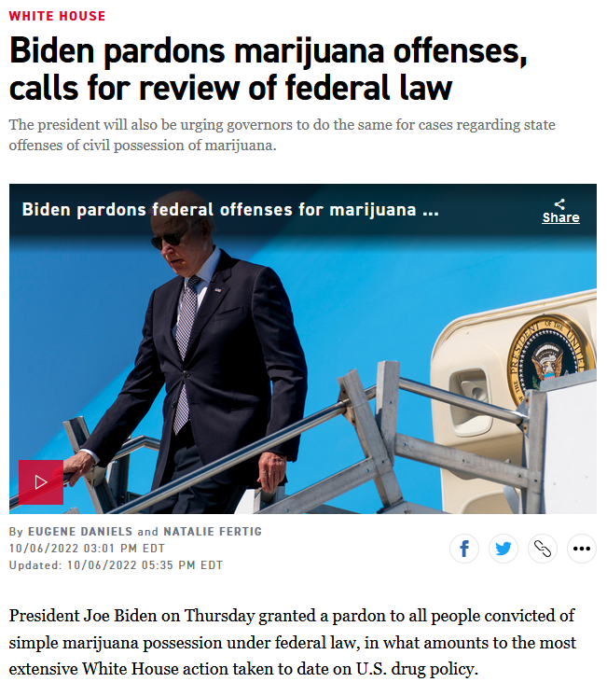

Slide 31
Medical Marijuana – Federal Law
    Under the Controlled Substances Act, 21 U.S.C. § 811 marijuana is still classified as a Schedule 1 drug, meaning that the federal government views marijuana as highly addictive and having no medical value.
    The U.S. Department of Transportation has taken the position that medical marijuana does not constitute a valid medical explanation for a covered employee’s positive drug test result.
      When an employee is subject to mandatory testing under DOT regulations, medical marijuana does not constitute a valid explanation for the positive test result.

Slide 32
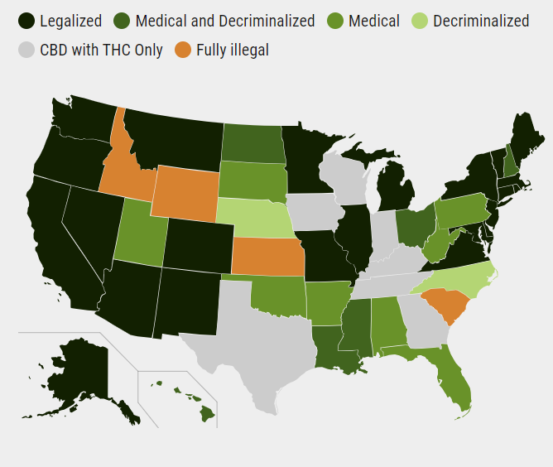
Legal Status of Marijuana

Slide 33
MN Medical Marijuana Program Overview
    Patients seeking medical marijuana must go through Minnesota Registry Program.
    Only legal to distribute and consume medical marijuana in pill, vapor, and liquid form.
    Smoking marijuana was unlawful
      On March 1, 2022 statute was amended to permit “combustion with use of dried raw cannabis.” 2021 Minn. Law ch. 30 art. 3 § 31.
    Cannot use marijuana in public places or at work.

Slide 34
Medical Marijuana – Employee Protections
    Provides employment protections for patients enrolled in the medical cannabis program:
      “[A]n employer may not discriminate . . . or otherwise penalize a person,” if the discrimination is based upon the person’s status as a qualified patient or a qualified patient’s positive drug test for cannabis components or metabolites.

Slide 35
Medical Marijuana (cont.)
    Exceptions:
      “[T]he patient used, possessed, or was impaired by medical cannabis on the premises of the place of employment or during the hours of employment."
      Failure to take action “would violate federal law or regulations or cause an employer to lose a monetary or licensing-related benefit under federal law or regulations.”
        E.g., a CMV driver, pilot (i.e., job regulated by federal drug testing).

Slide 36
How Does an Employee “Prove” they have a Prescription?
    Section 152.32, subd. 3(d) provides that “[a]n employee who is required to undergo employer drug testing pursuant to section 181.953 may present verification of enrollment in the patient registry as part of the employee's explanation under section 181.953, subdivision 6”

Slide 37
Employment Protections
    Nothing in Minnesota’s Medical Cannabis law allows an employee to use, possess, or be impaired by medical cannabis while on duty.
    In fact, all use of medical cannabis must occur during non-working hours and in such a manner that does not result in impairment at a future time on the job.
    So, employers should include a provision in their policy that prohibits the use of, possession of, and impairment by marijuana on company premises and during work hours.

Slide 38


THC Edibles

Slide 39
What About Edibles?
    Effective July 1, 2022, Minnesota enacted a law which allows small amounts of hemp-derived THC (either delta 8 or delta 9) products in food and beverages.
    How much THC?
      No more than 0.3% of any hemp-derived THC and the product may not contain more than 5 mg of THC per serving or 50 mg per package.

Slide 40
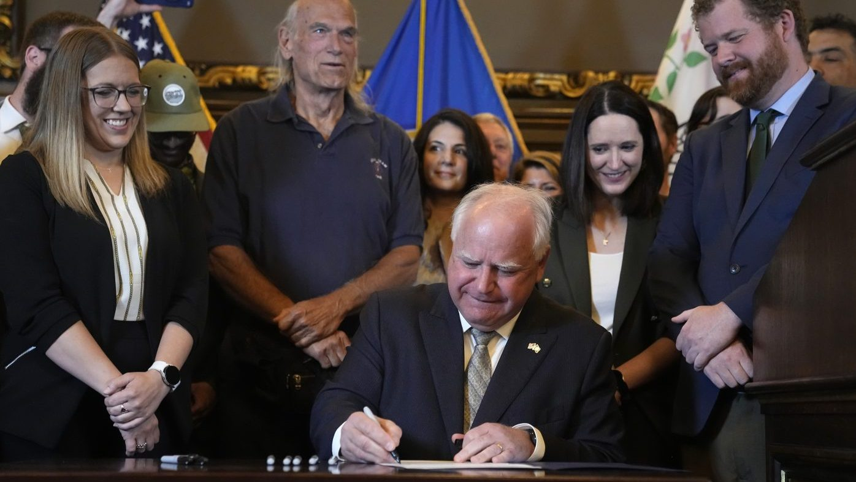
Recreational Marijuana (eff. 7/1/23)

Slide 41
MN Cannabis Law (HF 100)
    Any person aged 21 or older may:
      Possess up to 2 ounces of cannabis flower in a public place or 2 pounds in a person’s residence;
      Possess or transport no more than 8 grams of adult-use cannabis concentrate;
      Possess or transport edible products infused with up to 800 milligrams of THC;
      Give away cannabis flower and cannabinoid products in an amount that is legal for a person to possess in public;
      Use cannabis flower and cannabinoid products in private areas; and
      Cultivate up to eight cannabis plants, of which four or fewer may be mature, flowering plants.

Slide 42
MN Cannabis Law (cont.)
    The new law makes other significant changes to other Minnesota laws including:
      Creating more than a dozen types of licenses for growing, selling, transporting and testing cannabis;
      Creating an Office of Cannabis Management to regulate cannabis and take enforcement actions;
      Taxing cannabis retail sales at 8%, in addition to any already imposed local or state taxes;
      Creating and funding programs to combat cannabis abuse;
      Creating grants to assist individuals entering the legal cannabis market;
      Eliminating criminal penalties for cannabis possession; and
      Expunging the criminal records of people previously convicted of low-level cannabis offenses.

Slide 43
MN Drug Testing Policies after HF100
    HF 100 requires substantial amendments to drug testing policies.
    Amendments are effective July 1, 2023, because HF 100 is considered an “appropriations” bill.
      Minn. Stat. § 645.02

Slide 44
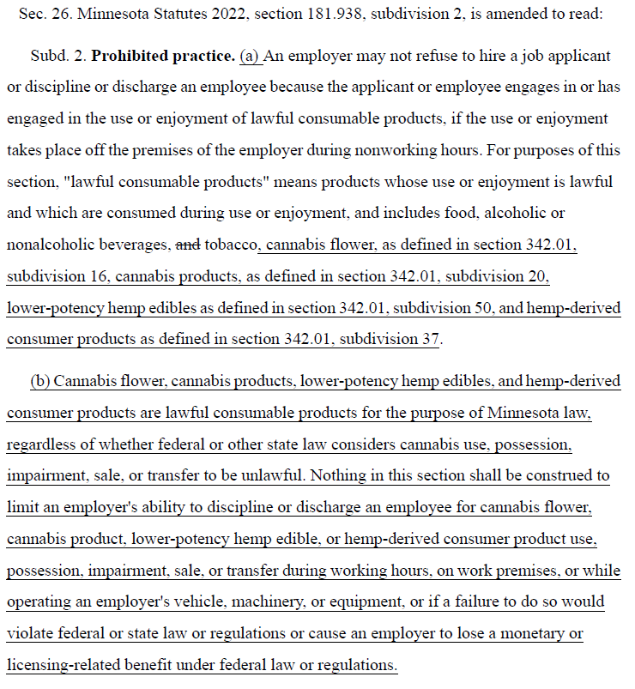
Amendments to the Lawful Consumable Products Statute

Slide 45
Amendments to the Lawful Consumable Products Statute (cont.)

Slide 46
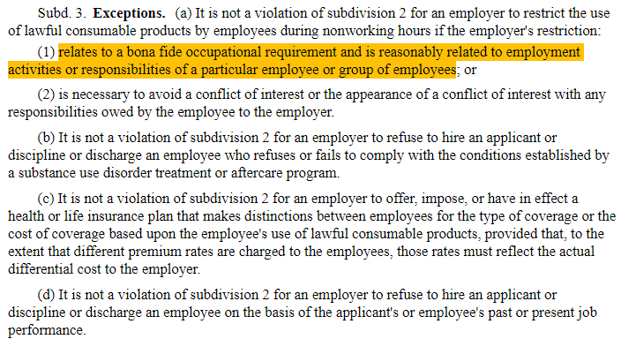
Exceptions to Lawful Consumable Products

Slide 47
Amendments to the Lawful Consumable Products Statute
Nothing in this section shall be construed to limit an employer's ability to discipline or discharge an employee for cannabis flower, cannabis product, lower-potency hemp edible, or hemp-derived consumer product
  Use, possession, impairment, sale, or transfer during working hours, on work premises,
  or while operating an employer's vehicle, machinery, or equipment,
  or if a failure to do so would violate federal or state law or regulations or cause an employer to lose a monetary or licensing-related benefit under federal law or regulations.

Slide 48
DATWA Amendments
    HF 100 creates a new type of testing, called “cannabis testing,” in addition to “drug and alcohol testing.”
    Place restrictions on “cannabis testing” by employers, unless such testing was required by “state or federal law.”
    HF 100 creates an “exception” to “cannabis testing” for seven classes of employees.
      For employees in these classifications, cannabis is considered a “drug” and subject to “drug and alcohol testing” under DATWA.

Slide 49
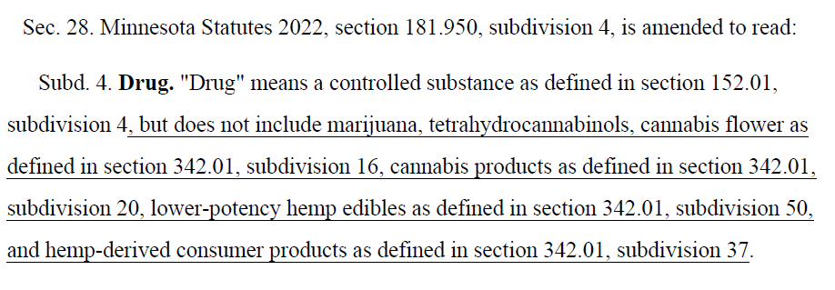
DATWA Amendments

Slide 50
DATWA Amendments (cont.)
    For employees in seven classifications, cannabis is considered a “drug” and subject to “drug and alcohol testing” under DATWA:
      (1) a safety-sensitive position, as defined in section 181.950, subdivision 13
      (2) a peace officer position, as defined in section 626.84, subdivision 1;
      (3) a firefighter position, as defined in section 299N.01, subdivision 3

Slide 51
DATWA Amendments (cont.)
    Exempt classifications (cont.)
      (4) a position requiring face-to-face care, training, education, supervision, counseling, consultation, or medical assistance to:
        (i) children;
        (ii) vulnerable adults, as defined in section 626.5572, subdivision 21; or
        (iii) patients who receive health care services from a provider for the treatment, examination, or emergency care of a medical, psychiatric, or mental condition;

Slide 52
DATWA Amendments (cont.)
    Exempt classifications (cont.)
      (5) a position requiring a commercial driver's license or requiring an employee to operate a motor vehicle for which state or federal law requires drug or alcohol testing of a job applicant or an employee;
      (6) a position of employment funded by a federal grant; or
      (7) any other position for which state or federal law requires testing of a job applicant or an employee for cannabis.

Slide 53
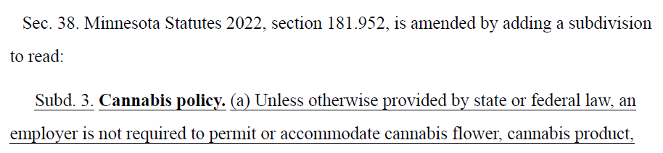
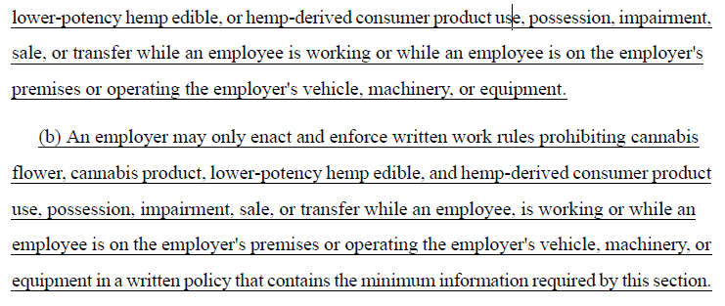
DATWA Amendments (cont.)

Slide 54
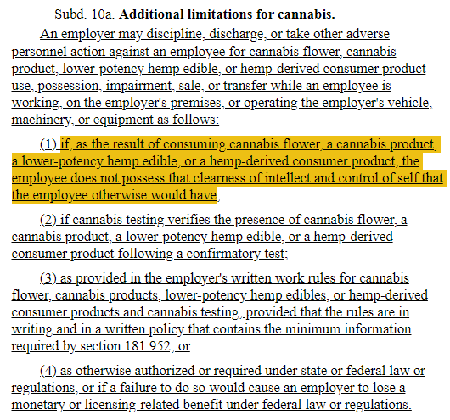
DATWA Amendments (cont.)

Slide 55
DATWA Amendments (cont.)

Slide 56
Summary of Key Changes
    The bill includes important limitations on “cannabis testing.”
      “An employer must not request or require a job applicant to undergo cannabis testing solely for the purpose of determining the presence or absence of cannabis as a condition of employment unless otherwise required by state or federal law.”
      “Unless otherwise required by state or federal law, an employer must not refuse to hire a job applicant solely because the job applicant submits to a cannabis test or a drug and alcohol test authorized by this section and the results of the test indicate the presence of cannabis.”
      “An employer must not request or require an employee or job applicant to undergo cannabis testing on an arbitrary or capricious basis.”

Slide 57
Update Prohibited Use Policies
    Address Cannabis in all policies.
    Ensure that employees are prohibited from using all forms of Cannabis at work or during work hours, possessing Cannabis/Marijuana at work or during work hours, or being impaired (not under the influence of) by Cannabis while at work.
    Address “edible cannabinoid products” and “intoxicating cannabinoids.”
    Make sure your policy covers the use of intoxicating lawful cannabinoids permitted by the new Minnesota statute.

Slide 58
Drug, Cannabis and Alcohol-Free Workplace Policy
The Company is committed to maintaining a work environment that is free from the influence of alcohol, illegal drugs, and cannabis, including cannabis products, lower-potency hemp edibles, and hemp-derived consumer products, to protect the health, safety, and well-being of our employees and the general public. As part of this commitment, the Company maintains an alcohol, drug, and cannabis-free workplace which is applicable to all employees working for the Company in the United States.

Slide 59
Drug, Cannabis and Alcohol-Free Workplace Policy
The Company prohibits reporting to work and working under the influence or impaired by alcohol, illegal drugs, and cannabis. It also prohibits the use, possession, distribution, transfer, and sale of alcohol, illegal drugs, and cannabis on all premises owned or operated by the Company (including parking areas), wherever work is being performed for the Company, and/or while operating any vehicle, machinery, or equipment owned or leased by the Company.

Slide 60
Drug, Cannabis and Alcohol-Free Workplace Policy
“Illegal drugs” means those substances whose distribution is controlled by regulation or statute, including but not limited to narcotics, depressants, stimulants, hallucinogens, and cannabis (marijuana), or prescription medications which contain a controlled substance, and which are used for a purpose for which or by a person for whom they were not prescribed or intended.
“Cannabis” means any cannabis products, including cannabis concentrate, cannabis flower, cannabis product, lower-potency hemp edible, or hemp-derived consumer products.

Slide 61
Drug, Cannabis and Alcohol-Free Workplace Policy
“Under the influence” or “impaired by” means, but is not limited by definition to, impairment of alertness, performance or behavior due to the ingestion, injection, inhalation or other application of any substance such that a person's motor senses (i.e., sight, hearing, balance, coordination, reaction, reflex), and/or judgment either are, or may reasonably be presumed to be, adversely affected. To be under the influence of or impaired by alcohol, drugs, or cannabis also includes a situation where an employee does not possess that clearness of intellect and control of self that the employee otherwise would have.

Slide 62
Drug, Cannabis and Alcohol-Free Workplace Policy
This policy does not prohibit:
1. The moderate consumption of alcoholic beverages at company-sponsored events or when the employee is approved for such consumption by the Company through a direct manager.
2. The possession of sealed bottles or cans of alcoholic beverages in an employee’s vehicle on company premises so long as this possession would be in compliance with state law if the vehicle were on a public street.

Slide 63
Drug, Cannabis and Alcohol-Free Workplace Policy
The legal possession of medical cannabis/ marijuana by an individual permitted to be in possession under state law which provides for such possession. An employee, however, may not use, possess, or be impaired by medical cannabis/ marijuana while on Company premises or the premises where the employee is working anywhere on behalf of the Company, or during the hours of employment by the Company. An employee may not operate any motor vehicle for or on behalf of the Company under the influence of medical cannabis/ marijuana. Use of medical cannabis at work, even if the employee is permitted such use by being on the registry, may result in discipline up to and including termination. The Company will not modify an individual’s position or working conditions or the requirements of this policy unless required to do so under applicable law.

Slide 64
Drug, Cannabis and Alcohol-Free Workplace Policy
Any violation of this policy is subject to disciplinary action, up to and including immediate termination of employment.
The Company encourages employees to seek help with any alcohol, drug, or cannabis problem, including substance use disorder and will support any employee desiring assistance. However, employees should seek help before the disorder affects their job performance. While alcohol, drug, or cannabis use disorder is itself is not grounds for discipline or discharge, any work problems resulting from such use or dependency will be dealt with as any other work-related problem and will be cause for discipline or discharge.
Treatment for substance abuse dependency may be covered under the Company’s group health insurance plan. For additional information, contact Human Resources

Slide 65
What is Impairment?
    What constitutes “impairment” may be hard to determine.
    Minnesota’s law has no definition of impairment other than the right of employers to act if, as the result of consuming cannabis flower, a cannabis product, a lower-potency hemp edible, or a hemp-derived consumer product, “the employee does not possess that clearness of intellect and control of self that the employee otherwise would have.”

Slide 66


Slide 67
What is “Reasonable Suspicion”?
    The goal of “reasonable suspicion” testing is identify employees who are impaired by alcohol and/or drugs in order to make the workplace safer.
    It is intended to—
      Address dangerous situations before they get worse
      Make your workplace safer for you, your employees, and customers
      Reduce liability

Slide 68
What Is “Reasonable”?
    More than a “hunch” or “guess,” but less than “probable cause.”
    Continuum of “Knowledge”
          Proof beyond a reasonable doubt
          Preponderance of evidence
          Probable cause
          Reasonable suspicion
          Having a “hunch” or “guess”
    Based on Totality of the Circumstances

Slide 69
What Is “Reasonable”? (cont.)
    Having sound judgment; fair and sensible
    A feeling or thought that something is possible, likely, or true
    A prudent person would come to the same conclusion given the same facts
    Supported or justified by fact or circumstance
    Must be based on “specific and articulable facts” taken together with rational inferences from those facts

Slide 70
MN-DATWA
    “Reasonable suspicion” means a basis for forming a belief based on specific facts and rational inferences drawn from those facts.
      Minn. Stat. § 181.950, subd. 13.

Slide 71
MN-DATWA
Reasonable Suspicion Testing
    Permitted if the employer has a reasonable suspicion that the employee:
      Is under the influence of drugs or alcohol;
      Violates written rules for use, possession, sale, transfer of drugs or alcohol (including cannabis)
      Sustained a personal injury to self or another employee
      Caused a work-related accident.

Slide 72
Reasonable Suspicion Process
Observe—What do you see, smell, hear?
Document—Use objective language
Confront and Converse—Be direct but supportive
Make a Conclusion—Know your organization’s guidelines
Services and Treatment

Slide 73
Reasonable Suspicion ABCs
    Appearance
    Behavior
    Conduct

Slide 74
Appearance
    Physical changes
    Overt physical signs such as:
      Hyperactivity
      Change in speech patterns
      Poor coordination
      Bruxism
      Muscle tone/tremors

Slide 75
Behavior
    Frequent, prolonged and often unexplained absences
    Involvement in accidents (both on and off the job)
    Inappropriate excuses for behavior

Slide 76
Conduct
    Erratic work patterns and reduced productivity
    Changes in friends and associates
    Improper reaction to real or imagined criticism
    Difficulty concentrating on more than one thing at a time (mental task and physical tasks)

Slide 77
Initial Questions to Ask
Has some form of impairment been shown in the employee's appearance, actions or work performance?
Does the impairment result from the possible use of drugs or alcohol?
Are the facts reliable? Did you witness the situation personally, or are you sure that the witness(es) are reliable and have provided firsthand information?
Are the facts capable of explanation?
Are the facts capable of documentation?
Is the impairment current, today, now?

Slide 78
Reasonable Suspicion Checklist
Record signs and symptoms
Confer with an onsite supervisor
Relieve the employee of duties
Complete documentation
Confront Employee (with witness)
Make a Decision
Implement the Decision

Slide 79
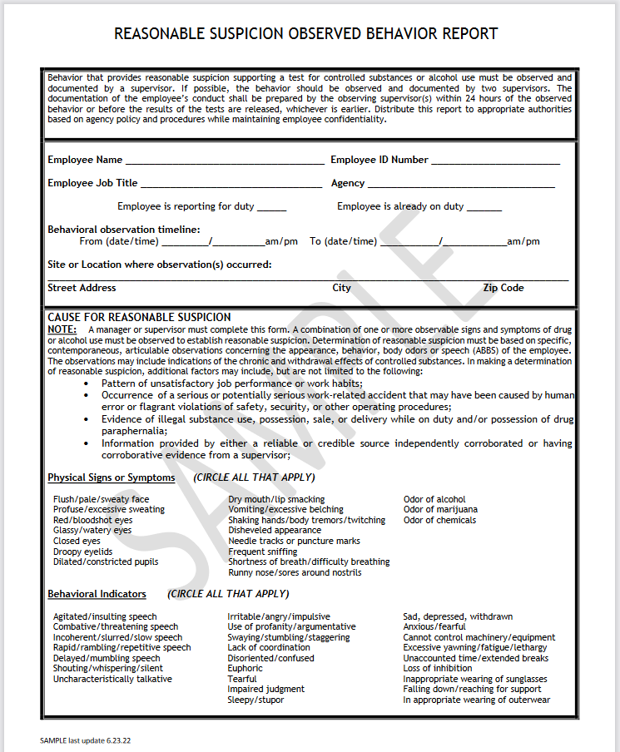
Source: https://www.nj.gov/cannabis/documents/businesses/Business%20Resources/Workplace%20Impairment%20Guidance%20Sample%20Form.pdf

Slide 80
Source: https://www.nj.gov/cannabis/documents/businesses/Business%20Resources/Workplace%20Impairment%20Guidance%20Sample%20Form.pdf

Slide 81
Source: https://www.nj.gov/cannabis/documents/businesses/Business%20Resources/Workplace%20Impairment%20Guidance%20Sample%20Form.pdf

Slide 82
Source: https://www.nj.gov/cannabis/documents/businesses/Business%20Resources/Workplace%20Impairment%20Guidance%20Sample%20Form.pdf

Slide 83
Source: https://www.nj.gov/cannabis/documents/businesses/Business%20Resources/Workplace%20Impairment%20Guidance%20Sample%20Form.pdf

Slide 84
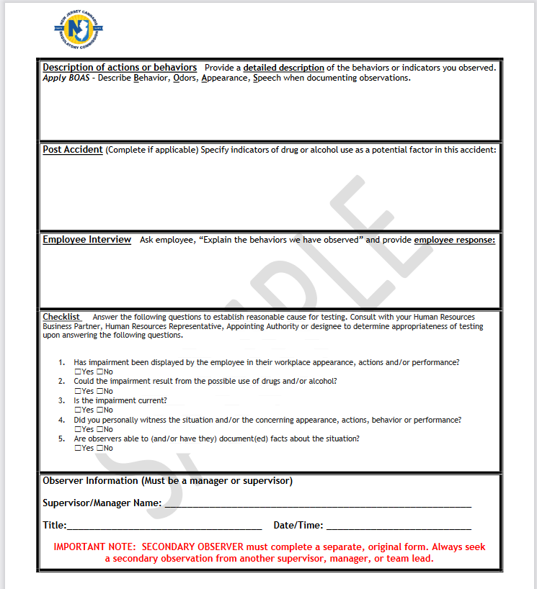
Source: https://www.nj.gov/cannabis/documents/businesses/Business%20Resources/Workplace%20Impairment%20Guidance%20Sample%20Form.pdf

Slide 85
Source: https://www.nj.gov/cannabis/documents/businesses/Business%20Resources/Workplace%20Impairment%20Guidance%20Sample%20Form.pdf

Slide 86
Source: Peter Swann, M.D., FACOEM, FAAFP, MRO

Slide 87
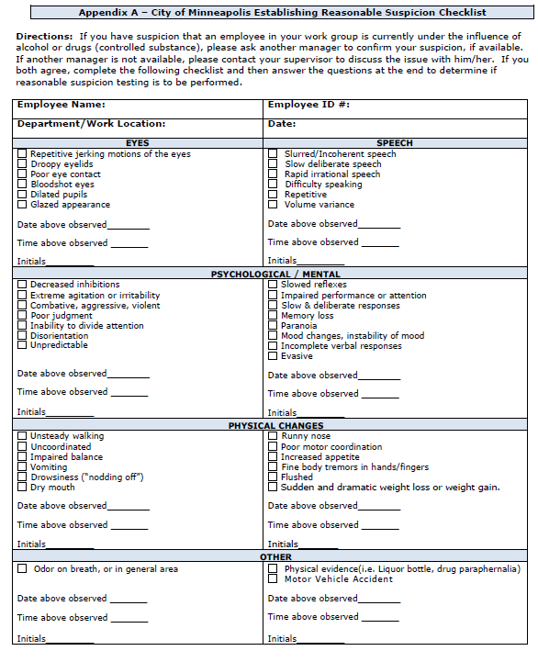
Source: City of Minneapolis

Slide 88
Source: City of Minneapolis

Slide 89
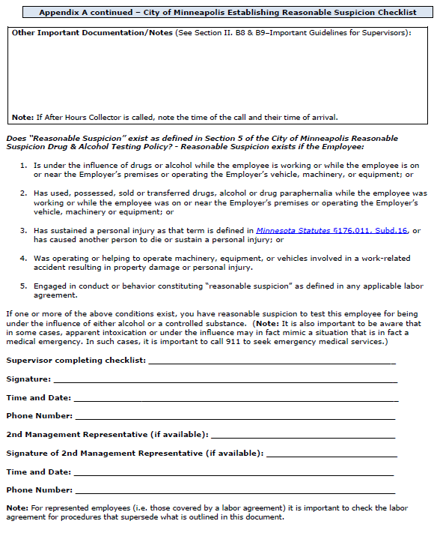
Source: City of Minneapolis

Slide 90
Source: City of Minneapolis

Slide 91
Source: City of Minneapolis

Slide 92
Confronting the Employee
    Collect all information
    Get confirmation whenever possible
    Use only objective data
    Consult with HR and/or EAP
    Speak to employee in private
    Be specific—state your concerns and why
    Be prepared for emotional response
    Explain expectations and/or consequences
    Do not allow employee to leave premises on their own
    Document the meeting

Slide 93
Don’t
    Confront in Public
    Diagnose
    Moralize

Slide 94
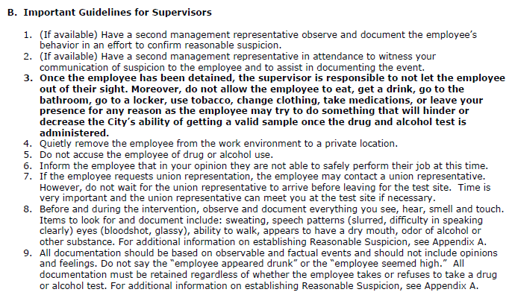
Source: City of Minneapolis

Slide 95
Is Testing Needed?
    Without the results of a drug test, an employer may run into legal issues for terminating an employee for “being under the influence” without having them to submit to a test.
  The results of a drug test is the only way to confirm that an individual is under the influence.
  However, there are limited circumstances where a test may not be needed, for example, if an employee is found using drugs on the job site, or if they possess drug paraphernalia during work time or behave outrageously.

Slide 96
Is Testing Needed? (cont.)
    Possession of paraphernalia (such as pipe, syringe, bent spoon, metal bottle cap, medicine dropper, glassine bag, paint can, glue tube, nitrite bulb, or aerosol can) can be used as a basis for adverse employment action.
    Similarly, taking adverse action for an employee’s possession of drugs or alcohol in the workplace can result in termination without a test.
    In addition to prohibiting employees being under the influence of drugs while working, policies should prohibit the possession of drugs by employees as well.

Slide 97
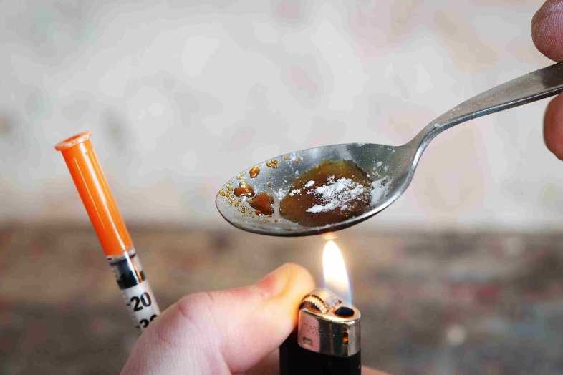
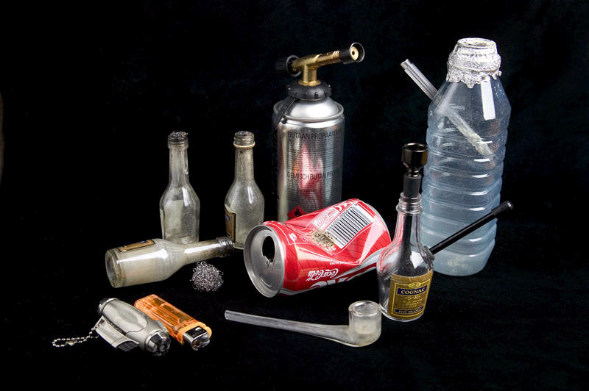
Drug Paraphernalia
    Heroine
    Crack Cocaine

Slide 98
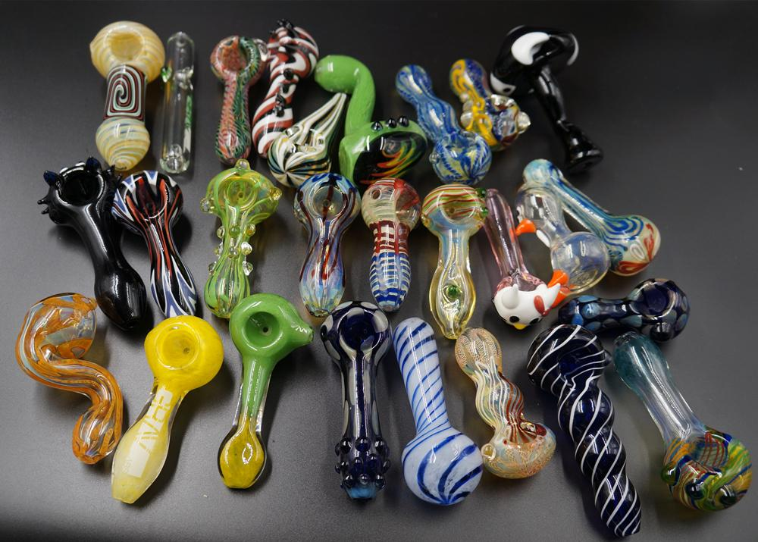
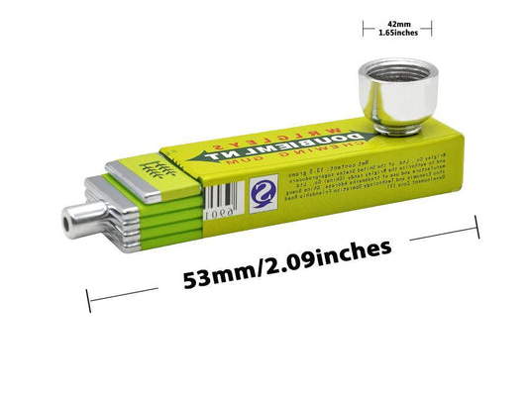
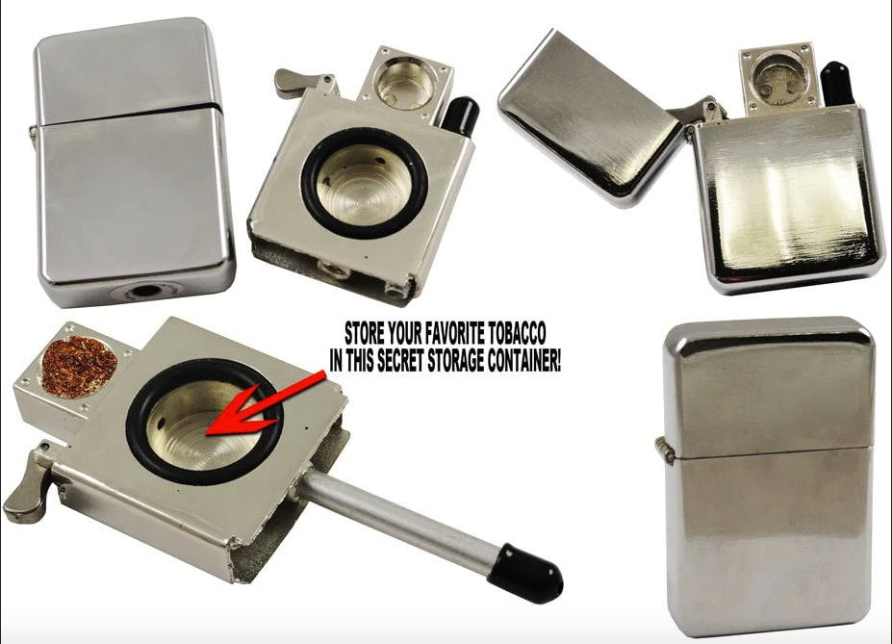
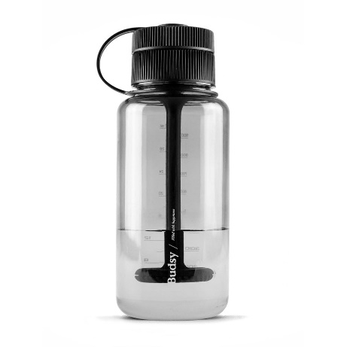
Drug Paraphernalia (cont.)
    Cannabis

Slide 99
What If Employee Leaves?
    Tell employee that you’ll call the police
    Call 911
    Give 911 your name and location
    Give circumstances (member was suspected to be under the influence)
    Explain that you warned him/her not to leave
    Give a description of the car, location, etc.

Slide 100
QUESTIONS?
Thank you.

