Slide 1
Health Economics Program: Research & Oversight
MN Ambulatory Surgery Center Association (MNASCA)
Hopkins, MN, October 5, 2023

Slide 2
Overview
Who we are
What we do
A tour of new activities
Health care transaction oversight

Slide 3
The Health Economics Program: Who We Are
The Health Economics Program (HEP) conducts research and applied policy analysis to:
Monitor changes in the health care market
Understand factors influencing health care cost, quality and access
Provide objective, technical assistance to policymakers.
Our work is data-driven
It is available as reports, issue briefs, data dashboards, presentation slides & testimony
MNHA: Monitoring Access / Cvrg
Telehealth Study
Hospital Bed Moratorium
Rx Price Transparency
Maintaining & Analyzing MN APCD
Monitoring Spending & Costs
Notes:
Work by others:
Rural and underserved clinical rotation grant program w/ focus on primary care
Primary Care Residency training grant program
Pediatric Primary Care Mental Health training grant program

Slide 4
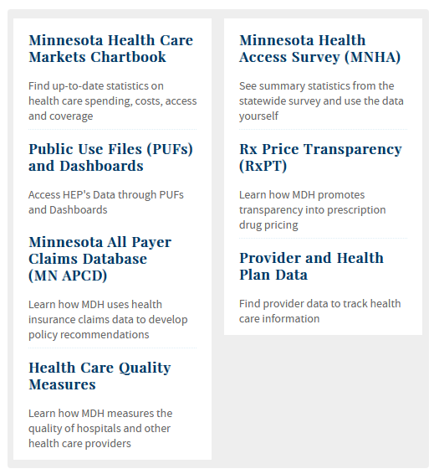
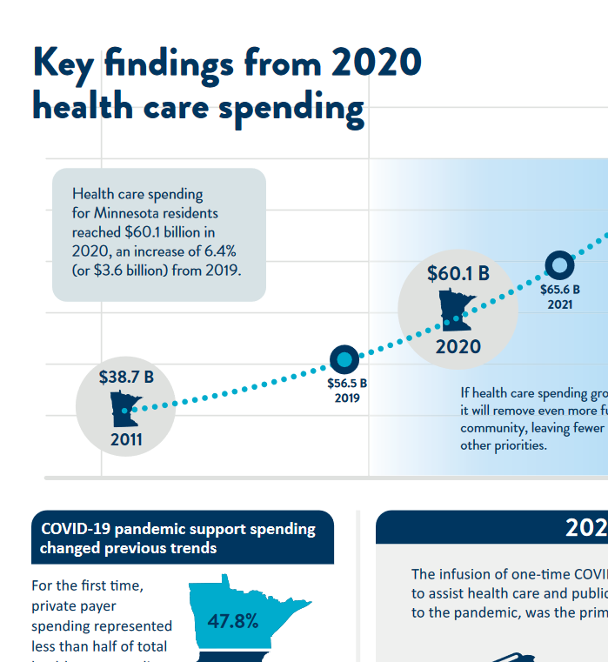
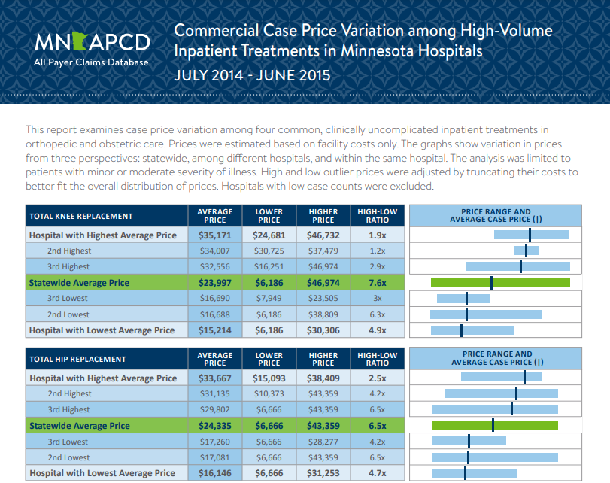
The Health Economics Program: What We Do

Slide 5
A Number of New Initiatives

Slide 6
Some New Initiatives
Affordability Center
Add’ Rx Transparency
More Effective Use of MN APCD
Studies on Health System Finance
Health Care Entity Transactions
Transparency of Health Care Payments

Slide 7
Tracking New Initiatives
Where to start: www.health.state.mn.us/data/economics/updates.html
Initial Postings:
2023 MN Legislative Session: New Duties for the Health Economics Program: www.health.state.mn.us/data/economics/docs/2023legsummary.pdf
Summary of new work specific to the Minnesota All Payer Claims Database (MN APCD): 2023 MN APCD New Initiatives Fact Sheet (PDF).
RFI on HMO conversion study: www.health.state.mn.us/facilities/insurance/managedcare/hmostudy.html
Summary of new work related to Rx Transparency (forthcoming)
… more to follow this fall.

Slide 8
Health Care Entity Transaction Oversight (this set of slides does not represent legal advice!)
Legislature was concerned about:
The impact of health care consolidations on costs, quality and access
The lack of transparency over the volume of transactions
The limited weight that existing (state & federal) oversight had
MN Stat 145D.01 & 145D.02 was to
empower state officials to (more) effectively manage health care entity transactions that might be contrary to public interest and
create sightlines on market changes
Builds on existing AGO authority in Charities Law and Antitrust Law and the MDH health care market oversight responsibility

Slide 9
Health Care Entity Transactions, cont’d. 1
145D.01 (AGO + MDH)
Certain health care entity transactions where one entity has average revenue of $80M per year
Notice and information prior to close of transaction
AGO has authority to sue to enjoin a transaction
Effective on passage
145D.01 (MDH)
Certain health care entity transactions where one entity has average revenue of between $10M and $80M per year
Provide MDH notice prior to close of transaction
MDH to monitor and report on trends in transactions
Effective Jan 1, 2024

Slide 10
Health Care Entity Transactions, cont’d. 2
Additional detail in law:
Definitions (e.g., health care entity, transactions, exceptions)
Notice period & submission requirements (fewer for 145D.02)
Public interest standards
Prohibited transactions & enforcement authority
Opportunity to seek public input
For questions:
AGO: health.notices@ag.state.mn.us; www.ag.state.mn.us/Health-Care/Transactions/
MDH: health.hctransactions@state.mn.us; additional information & guidance forthcoming
Notes:
Harm public health
Reduce access to affordable quality care
Negative impact on competing health care options
Reduce health care to disadvantaged, uninsured, underinsured, and underserved populations and publicly enrolled
Substantial negative impact on medication education, teaching, workforce training or medical research
Negatively affects markets for health care services, health insurance services, skilled health care workers
Increase health care costs for patients
Adversely impact provider cost trends and containment of total health care spending
Negatively affect wages and employment

Slide 11
Thank You! -- Add’l Resources
Health Economics Program homepage: MDH, Health Economics Program
MN APCD homepage/dashboard: Minnesota All Payer Claims Database (MN APCD)
RxPT homepage/dashboard: Rx Price Transparency & Data
Health Care Market Slides: Chartbooks

Slide 12
Health Regulation Division presentation to ASC conference 10/5/23
Maria King, RN| Division Director
maria.king@state.mn.us

Slide 13
Who is the Health Regulation Division?
The Health Regulation Division (HRD) in MDH protects the health and safety of Minnesota citizens receiving care in Minnesota healthcare settings.
In addition, the HRD staff perform various regulatory activities, such as:
Issuing state licenses and federal certifications.
Completing inspections, investigations, reviews, or audits.
Administering registries.
Taking compliance or enforcement actions when necessary.
Providing information to consumers and providers.

Slide 14
Who We Regulate
HRD regulates 40 different types of providers and organizations including:
Healthcare Facilities includes Ambulatory Surgery Centers
Health Professions
Body Artist & Piercers

Slide 15
Regulatory Activities
Our regulatory activities protect Minnesotans from before birth to after death.
Birth - doula registry program
Death - oversight of morticians and funeral establishments.
We have a strong relationship with the Centers for Medicare and Medicaid Services (CMS) for the many health facilities that are federally certified.
We protect the health and safety of Minnesota’s nursing home residents, home care clients, hospital patients, surgery center patients, people with intellectual disabilities, families obtaining services at funeral establishments, birth center clients, body art establishment clients, and other clients of health care.

Slide 16
Protecting Health & Safety
MDH is responsible to follow CMS Mission and Priority Document
Link to 2023 MPD: https://www.cms.gov/files/document/admin-22-10-all.pdf
Ambulatory Surgery Center info starts on page 11.
https://www.cms.gov/Regulations-and-Guidance/Guidance/Manuals/downloads/som107_exhibit_351.pdf

Slide 17
Protecting Health & Safety

Slide 18
Protecting Health & Safety

Slide 19
MDH HRD Licensing and Certification
Licenses and oversees-
Health care facilities, including:
Nursing homes
Boarding care homes
Supervised living facilities
Hospitals,
Ambulatory surgical centers
Clinical labs
Federally certified home health agencies, birth centers, housing with services, hospice, dialysis providers and other providers

Slide 20
Office of Health Facility Complaints
Office of Health Facility Complaints
Investigates reports of maltreatment, in accordance with the Vulnerable Adults Act and other complaints of abuse, neglect, or maltreatment in licensed healthcare facilities
Investigates complaints in federally-certified and state-licensed facilities, including nursing homes and hospitals
Conducts reviews of requests for set asides of criminal/maltreatment incidences for individuals who request to work in licensed healthcare facilities

Slide 21
Engineering Services
Engineering Services
Reviews and approves all architectural and engineering plans relating to new construction and/or modifications to existing health care facilities to ensure that facilities meet state and federal building and fire codes
Conducts on-site construction inspections to assure that projects are built in accordance with approved construction documents

Slide 22
Protecting Older Minnesotans & Vulnerable Adults
Much of our work focuses on protecting older Minnesotans and vulnerable adults.
As Minnesota’s population ages over the next 20 years, older residents will require an increasing amount of health services and the need for health protection will become even more important.
An integrated Assisted Living license was recently implemented to:
Provide regulatory Oversight of:
Housing and Services
Enhance protections to the residents living in these facilities

Slide 23
Health Regulation Division in the Community
Communication in the Community
Sensitive to barriers in communities during surveys and investigations such as need for interpreters, allowing extra time for communication, using plain language.
Established separate call center to ensure better response and having a live-person answer every call
Staying connected to Cultural, Faith and Disabilities Branch created during height of COVID 19 response.
Taking the time needed to answer questions when someone is facing a possible maltreatment disqualification affecting their livelihoods

Slide 24
Collaboration and Accessibility
Collaborative Safety initiative underway which includes providers and consumer advocates to get at the complex reasons behind violations.
Websites are being updated improving content and ensuring accessibility
Doula certification project involved BIPOC communities
Partnership with DOC to develop first ever licensed tattoo supervisor and training program in MN prisons to ensure safe tattooing practices and develop job skills for inmates when they leave. In pilot stage now

Slide 25
Types of Data
The Health Regulation Division utilizes many types of data.
Call Center data
Number of Licensees
Resident capacity
Number and type of citations
Complaints triaged and investigated
Closure data and CHOW data
Staff time data for planning purposes
Appeals data
Reports from CMS about our surveys

Slide 26
Working with Outside Agencies
Ways we have/continue to work with outside agencies on one-time projects:
Partner regularly with:
providers and consumers about messages, policies and proposals
Partner regularly with DHS (CHOW, NHs, Medicaid Waivers)
Nursing Home Receiverships are in partnership with DHS and OOLTC’s Office
Work specifically with DHS, OOLTC, OMHDD on closures
Speaking engagements
Work with DHS who conduct background studies for the providers we license
For annual NH Moratorium Committee process, we convene a committee with DHS, OOLTC, and include providers
Initiated a division redesign using consultants who continue to help us with implementation

Slide 27
Land Acknowledgement
Every community owes its existence and vitality to generations from around the world who contributed their hopes, dreams, and energy to making the history that led to this moment. Some were brought here against their will, some were drawn to leave their distant homes in hope of a better life, and some have lived on this land for more generations than can be counted. Truth and acknowledgment are critical to building mutual respect and connection across all barriers of heritage and difference.
We begin this effort to acknowledge what has been buried by honoring the truth. We are standing on the ancestral lands of the Dakota people. We want to acknowledge the Dakota, the Ojibwe, the Ho Chunk, and the other nations of people who also called this place home. We pay respects to their elders past and present. Please take a moment to consider the treaties made by the Tribal nations that entitle non-Native people to live and work on traditional Native lands. Consider the many legacies of violence, displacement, migration, and settlement that bring us together here today. Please join us in uncovering such truths at any and all public events.*
*This is the acknowledgment given in the USDAC Honor Native Land Guide – edited to reflect this space by Shannon Geshick, MTAG, Executive Director Minnesota Indian Affairs Council

Slide 28
Thank You!
Maria King, RN
Maria.King@state.mn.us
507-344-2716

Slide 29
MDH Updates for MNASCA
Nicole Osterloh| Federal Operations Supervisor & Lead ASC Supervisor

Slide 30
Agenda
CMS Mission and Priorities Document for 2023.
Survey Activities
Process for New Ambulatory Surgical Centers

Slide 31
2023 Mission and Priorities document Admin 22-10-ALL (cms.gov).

Slide 32
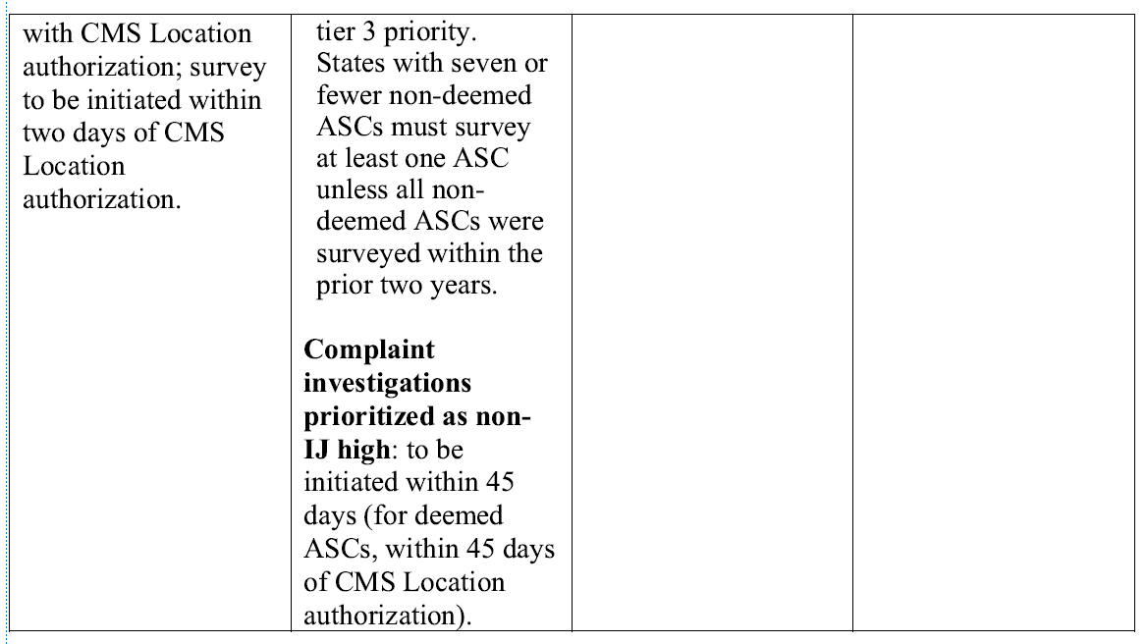
Cont. M&P

Slide 33
Cont. M&P
NOTE: NON-DEEMED ASC are the same as above for Tier 1, but do not require prior authorization by the CMS RO.

Slide 34
Survey Activity x 1 year
MDH has investigated 3 Immediate Jeopardy Complaints with ASC within the last year.
MDH cited a deficiency at 1 of the 3 complaints related to Physical Environment, at a condition level related to mold.

Slide 35
Survey Activity x 1 year
The MDH has completed 11 State Licensure Walkthroughs for new construction.
*There are 5 pending licensure walkthroughs currently.

Slide 36
Initial Steps in New Construction ASC
MDH receives the application and fee to our administration support staff.
The admin support staff then forwards the application and fee to the deposit team.
The deposit team then applies the payment.
The admin support scans your application into the federal licensing daily mail folder.

Slide 37
Initial Steps in New Construction ASC
5. A Credentialer is assigned your application and assigns a Health Facility ID Number (HFID).
6. The Credentialer then sends a notification referral to Engineering, the MN Fire Marshal, and the Health Supervisor for Ambulatory Surgical Centers (Nicole Osterloh) to notify them of the upcoming new ASC and their anticipated date of opening.
7. Engineering reviews your plans and makes corrections, etc. until plans are approved.
8. Engineering must complete their paperwork and submit it to the MN Program Assurance (PA) staff (usually Amy Johnson).

Slide 38
Initial Steps in New Construction ASC
9. The Fire Marshal’s office then received the go ahead from PA to perform a walkthrough Life Safety Code survey. Depending on the results of the survey, items may need to be fixed or they can issue their clearance and submit their paperwork to PA.
10. PA then notifies the Health Supervisor to conduct the Health final portion of a State initial licensing walk through. ****Note: the ASC must be fully operational for MDH to conduct the initial licensing walk thru (Everything from instruments, to surgical supplies, contracts, Emergency Preparedness, credentialing of physicians and staff, etc. MUST be completed before we can do a health walkthrough). Surveys are booked 1 calendar month in advance per CMS requirements, so Nicole works with her trained ASC staff to check their availability of their schedules. Sometimes this can take a few weeks to get scheduled.

Slide 39
Initial Steps in New Construction ASC
11. Once a surveyor is assigned, they will reach out to you via email on a date and time to do your walkthrough, and documents they will be requesting be available upon entrance. (This is the only time we announce a survey).
12. The Health team then conducts the initial licensing Health survey. Some things may require adjusting, or they recommend licensure and notify PA staff of the survey results based of Health Walkthrough.
13. PA staff works to close the Health portion of the process and issues a license.
14. At this time, the ASC must work with an accrediting organization to perform the initial certification survey vs the State Agency, MDH.

Slide 40
MDH ASC MAIN PAGE
Freestanding Outpatient Surgical Center Licensing - MN Dept. of Health (state.mn.us)
On this page:
Federal Certification Process for Ambulatory Surgical Centers for additional information and forms required for participation as a Medicare-certified Ambulatory Surgical Center.
Other Required forms and documents.
Related statutes and rules.

Slide 41
Contacts
Amy Johnson: HRD Health Program Rep amy.lee.johnson@state.mn.us
Shellae Dietrich: HRD Health Program Manager shellae.dietrich@state.mn.us
Nicole Osterloh: HRD Federal Operations Supervisor nicole.osterloh@state.mn.us
Maria King: HRD Division Director maria.king@state.mn.us

Slide 42
Thank You!
Nicole Osterloh- Federal Operations Supervisor
nicole.osterloh@state.mn.us
507-476-4230

