Slide 1
Service Line QI Support of the ASC
Ryan Larson
Director, System Quality Improvement & Specialty Program Development
TRIA Orthopedics

Slide 2
QI is not QA (Assurance) or QC (Control)
Process Owner “takes back” process and promotes improvements
QA & QC monitor current level of performance/ quality of the process
QA & QC monitor new level of performance/ quality of the process
QI responds and Process Owner “hands over” process and provides necessary staff to act as team members. QI Identifies causes with team and implements solutions.
2

Slide 3
QI Activities We Support
Analysis
An operational question needs to be answered
Data can either already exist (pull from data base), or needs to be gathered (manual observations)
Metric Creation
Development of operational KPIs to improve process understanding and control
Education & Coaching
Educating and coaching team on QI tools and principles
Just-Do-It
The cause of a process issue is known and a solution is relatively simple
Usually contained to one team or department
Tool Facilitation
Facilitation for a group or team currently engaged in an initiative is required (i.e. brainstorming session, issue identification and prioritization, process mapping, 5-whys/ root cause analysis, etc.)
QI Project:
Begins with an issue, the cause of which is unknown and improvement is needed
Focus is on processes and operations
Can span multiple departments or facilities

Slide 4
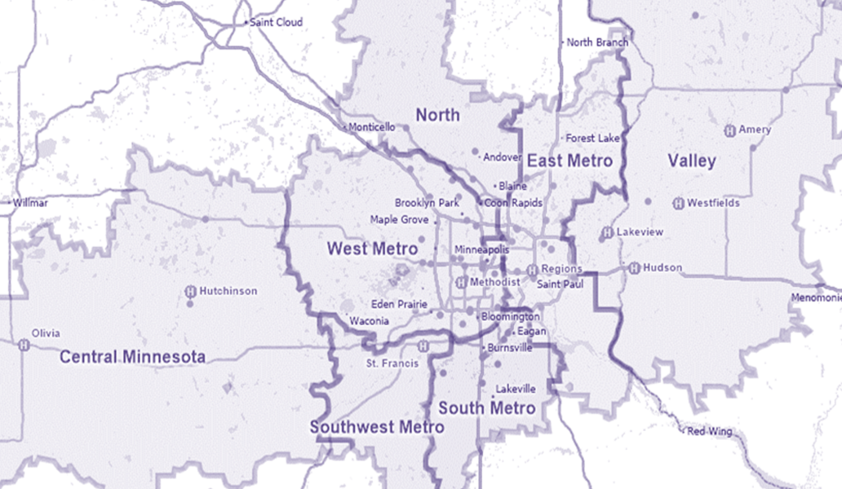
TRIA Locations – Framing the Problem
Full-service site: ASC, Clinic, Ortho Urgent Care, Rehab
Clinic / Doctors
Rehabilitation

Slide 5
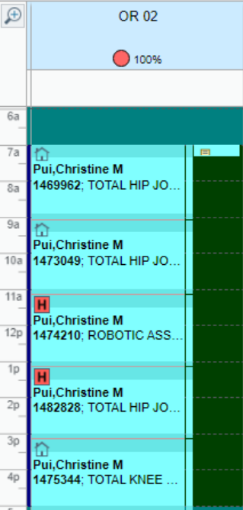
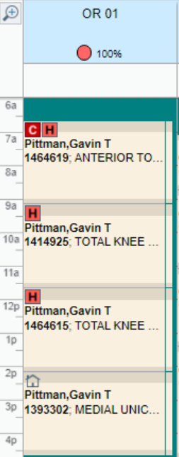
Operational Issue/Question
Our goal is to safely perform all appropriate Total Joint Arthroplasty cases at our ASC’s in a timely manner
Our ability to do this has been variable by geography (east vs. west)
The primary barrier has been access to operating time
Is more time the solution?
SURGEON 2
SURGEON 1
SURGEON 2
SURGEON 1
SURGEON 2
SURGEON 2
SURGEON 1
SURGEON 2
SURGEON 1

Slide 6
Initial Data Analysis
THA
10 Min Longer
TKA
7 Min Longer
40-45 Min Longer
20-25 Min Longer

Slide 7
Time Study
Trial Observation (10 cases) to develop scope/areas of focus
Scope:
“Patient In” to “Patient Out”
Procs: Anterior THA, Posterior THA, TKA, Robotic TKA
Locations: TRIA BL, TRIA WB, Methodist, Lakeview
Areas of Focus defined by trial observation:
“Patient In” to “Time Out” – Process Focus
Number of instrument handoffs
Time from Request to Handoff
Closure – Assist Experience
*To Date we have completed more than 50 observations with 12 of our surgeons

Slide 8
Preliminary Time Study Findings
In Room to Incision
Anesthesia Type (General vs. Spinal)
Equipment/Table Selection
Linear vs. Concurrent “Flow”
Cut to Close
Anterior vs. Posterior Approach – Anterior adds 10-20% to case length vs. posterior
Robot/Navigation
Tech Experience – <200 cases/year = 33% longer per instrument handoff vs. >200 cases/year
Closure
Varying techniques, product use, skillset/confidence/trust can drive as much as a 50% difference in time

Slide 9
Closing Note
Remember our goal: Our goal is to safely perform all appropriate Total Joint Arthroplasty cases at our ASC’s in a timely manner
It isn’t just about a single metric (time), we need to balance this with an outcome metric(s) to ensure we are providing both efficient care/access to care but also optimal care

