Slide 1
Health Economics Program: Research & Oversight
MN Ambulatory Surgery Center Association (MNASCA)
Hopkins, MN, October 5, 2023

Slide 2
Overview
Who we are
What we do
A tour of new activities
Health care transaction oversight

Slide 3
The Health Economics Program: Who We Are
The Health Economics Program (HEP) conducts research and applied policy analysis to:
Monitor changes in the health care market
Understand factors influencing health care cost, quality and access
Provide objective, technical assistance to policymakers.
Our work is data-driven
It is available as reports, issue briefs, data dashboards, presentation slides & testimony
MNHA: Monitoring Access / Cvrg
Telehealth Study
Hospital Bed Moratorium
Rx Price Transparency
Maintaining & Analyzing MN APCD
Monitoring Spending & Costs
Notes:
Work by others:
Rural and underserved clinical rotation grant program w/ focus on primary care
Primary Care Residency training grant program
Pediatric Primary Care Mental Health training grant program

Slide 4
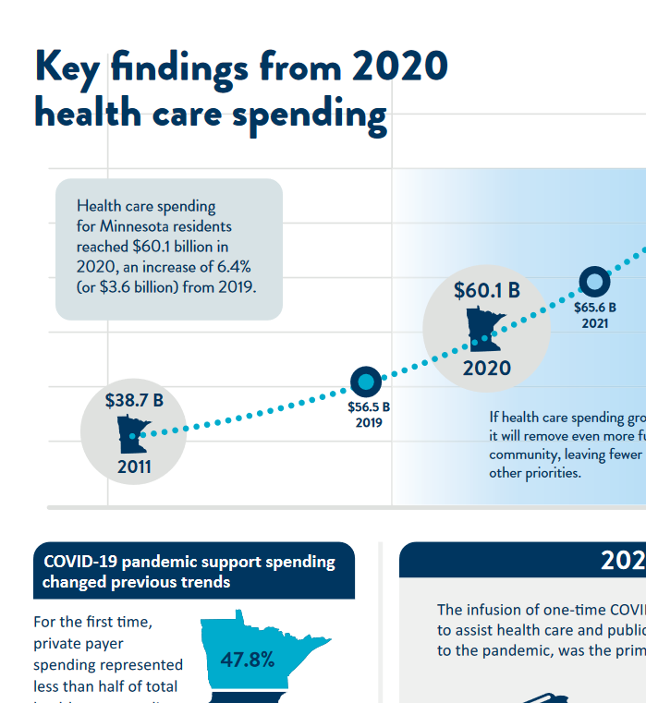
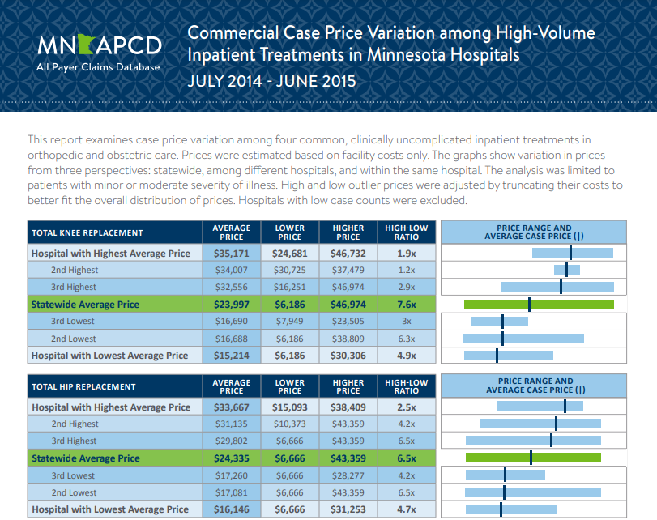
The Health Economics Program: What We Do

Slide 5
A Number of New Initiatives

Slide 6
Some New Initiatives
Affordability Center
Add’ Rx Transparency
More Effective Use of MN APCD
Studies on Health System Finance
Health Care Entity Transactions
Transparency of Health Care Payments

Slide 7
Tracking New Initiatives
Where to start: www.health.state.mn.us/data/economics/updates.html
Initial Postings:
2023 MN Legislative Session: New Duties for the Health Economics Program: www.health.state.mn.us/data/economics/docs/2023legsummary.pdf
Summary of new work specific to the Minnesota All Payer Claims Database (MN APCD): 2023 MN APCD New Initiatives Fact Sheet (PDF).
RFI on HMO conversion study: www.health.state.mn.us/facilities/insurance/managedcare/hmostudy.html
Summary of new work related to Rx Transparency (forthcoming)
… more to follow this fall.

Slide 8
Health Care Entity Transaction Oversight (this set of slides does not represent legal advice!)
Legislature was concerned about:
The impact of health care consolidations on costs, quality and access
The lack of transparency over the volume of transactions
The limited weight that existing (state & federal) oversight had
MN Stat 145D.01 & 145D.02 was to
empower state officials to (more) effectively manage health care entity transactions that might be contrary to public interest and
create sightlines on market changes
Builds on existing AGO authority in Charities Law and Antitrust Law and the MDH health care market oversight responsibility

Slide 9
Health Care Entity Transactions, cont’d. 1
145D.01 (AGO + MDH)
Certain health care entity transactions where one entity has average revenue of $80M per year
Notice and information prior to close of transaction
AGO has authority to sue to enjoin a transaction
Effective on passage
145D.01 (MDH)
Certain health care entity transactions where one entity has average revenue of between $10M and $80M per year
Provide MDH notice prior to close of transaction
MDH to monitor and report on trends in transactions
Effective Jan 1, 2024

Slide 10
Health Care Entity Transactions, cont’d. 2
Additional detail in law:
Definitions (e.g., health care entity, transactions, exceptions)
Notice period & submission requirements (fewer for 145D.02)
Public interest standards
Prohibited transactions & enforcement authority
Opportunity to seek public input
For questions:
AGO: health.notices@ag.state.mn.us; www.ag.state.mn.us/Health-Care/Transactions/
MDH: health.hctransactions@state.mn.us; additional information & guidance forthcoming
Notes:
Harm public health
Reduce access to affordable quality care
Negative impact on competing health care options
Reduce health care to disadvantaged, uninsured, underinsured, and underserved populations and publicly enrolled
Substantial negative impact on medication education, teaching, workforce training or medical research
Negatively affects markets for health care services, health insurance services, skilled health care workers
Increase health care costs for patients
Adversely impact provider cost trends and containment of total health care spending
Negatively affect wages and employment

Slide 11
Thank You! -- Add’l Resources
Health Economics Program homepage: MDH, Health Economics Program
MN APCD homepage/dashboard: Minnesota All Payer Claims Database (MN APCD)
RxPT homepage/dashboard: Rx Price Transparency & Data
Health Care Market Slides: Chartbooks

