Slide 1
Navigating Supply Chain Constraints
ROBERT Mayhew
Director, supply chain
Revo health

Slide 2
Objectives
2024 Outlook
ASC Supply Chain Management
  Discuss primary functions
    How to get value out of each function
  Review scenario – See one, do one, teach one

Slide 3
Supply Chain 2024 Outlook

Slide 4
Supply Chain 2024 Outlook
4-6% increase
  Disruptions
  Labor, cost of raw materials, operating expenses
Backorders
  Frequency returning to “normal”
  Pharmaceutical constraints
  Transportation delays
  Staffing constraints
  Expect costs to increase during contract renewals. Lean into your Supply Chain strategy to manage costs. Cover the basics to ensure your paying the correct price and avoiding unnecessary operating costs (i.e freight, loss of inventory, etc.).

Slide 5
Primary Functions of ASC Supply Chain Management

Slide 6
Advice on how to succeed as an ASC Materials Manager
Direct communication – Tell people what they need to know
Bring value – Are helpful in their actions
Care about the patient – The best interest of the patient guides them
Finance
Operations
Clinical

Slide 7
Functions of Healthcare Supply Chain
Contracts Management
Value Analysis
Strategic Sourcing
SCMIS/Data Analytics
Inventory Management
Operations
Purchasing
Core functions of Supply Chain
Can consist of more functions
Consistent between Acute and Non-Acute

Slide 8
Contracts Management

Slide 9
Group Purchasing Organizations (GPOs)
What are Group Purchasing Organizations
Types of Group Purchasing Organizations
  The Big Three
  Aggregator Groups or Channel Partners
  Specialty GPOs
    Specialty – Orthopedic, Ophthalmology, etc.
    Pharmaceutical
    Purchased or Ancillary Services – i.e., IT
    Misc. – i.e., Optical
Do I need a GPO?
How GPOs make money

Slide 10
Obtaining the value in GPO contracts
Contract Tiers
Awards – Single, Dual, Multi
Contract Commitments
  Letters of Commitment (LOCs, LOAs, Pricing Agreements, etc.)
  Market share
  Spend requirements
Contract expirations
Maximizing your GPO relationship
  Have access to the web portal
  Act on new contracts or renewals
  Understand terms and tiers
  Stay active on news and updates

Slide 11
Other Types of Contracts
Local or Facility
Regional or Group
Non-Contract
Document contracts
  In your SCMIS
  Contract Binder
  Excel file with key information
Know which contact serves as your “Source of Truth”

Slide 12
Key Concepts
Term and Auto Renewal
  Three year cap on term
  Auto-Renewal - Provide immediate notice
Termination
  Negotiate favorable termination language
  With or without cause
  Cure period
  Penalties
Vendor owned inventory
  Consignment
    Quarterly inventory reconciliation
  Placement of equipment
    Buy out - $1 or FMV
  Formal agreement; not trunk stock
Personal guarantee
  Only owners should sign

Slide 13
Contracts Management Summary
Know who is your GPO, have access to, and know how to navigate their website/member portal.
Maximize the GPO value to your center.
  Tiers
  Administrative Fees/Revenue Share back
Know all contract sources – “Source of Truth”
  Have a binder and excel sheet – list what to put in that excel sheet
  Validate pricing from vendors to your GPO or other contract source
Remember the key concepts – Terms, Renewal, Termination, Ownership, and Guarantees
Understand facility commitments (market share or spend requirements)

Slide 14
Value Analysis

Slide 15
What is Value Analysis?
Supply Chain “Defense”
Value Analysis is a formal review process of new products that encompasses
  Cost
  Reimbursement
  Clinical Review
Primarily has been a function in acute care facilities, IDNs, or Management Companies
Protects your facility from “unauthorized products”
  A defined and approved Value Analysis process gives something to push back against as needed
Not saying “No”; Instead your saying “Trust but verify”

Slide 16
Value Analysis for the ASC
Modify for the ASC
  Huddles not committees
  Rapid review
Model by procedure
  Consistent for most Value Analysis reviews
What product does this replace?

Slide 17
Value Analysis Summary
Supply Chain “Defense”
  Not saying “No” but saying “Trust but verify”
Typical structure
  Financial review
    Pricing
    Reimbursement
  Clinical review
  Model by procedure
Modified for the ASC
  Huddle
  Rapid review
What does this replace?

Slide 18
Strategic Sourcing

Slide 19
What is Strategic Sourcing?
Supply Chain “Offense”
Actively seeking out lower cost or more efficient options to currently used products or services
  Clinically equivalent or superior
Strategic Sourcing exercises are performed on a regular basis
  Regular reviews of products and services
  Strategic Sourcing calendar

Slide 20
Strategic Sourcing for the ASC
Model by category and vendor
  Rebates
  Market share or financial commitments
Involve others
  Sales reps and employees are great resources
Covid reset may be needed at your facility
  Pandemic caused shift from Strategic Sourcing to Reactive Sourcing
  As the health of Supply Chain has improved and continues to improve, shift back to strategic from reactive
Formularies

Slide 21
Strategic Sourcing Summary
Supply Chain “Offense”
Active process of regularly reviewing options for savings or gained efficiencies
Involve others – Sales Reps and Employees
Covid reset may be needed – Strategic vs Reactive sourcing
Formularies
Model by category and vendor
  Rebates
  Market share

Slide 22
Scenario
Is this Value Analysis or Strategic Sourcing?
Where do we begin?
Collect data - Purchase Order, Accounts Payable, and/or Charge Capture reports.
  Six months of detailed usage
  A large enough data set will always tell you a story.
As this is Strategic Sourcing, model by vendor and category.
Assign each vendor a “conversion difficulty value”
  1 to 4 with 1 being the easiest and 4 the most difficult
Identify opportunities based on spend, difficulty, and category.
Develop your sourcing strategy.
Act on your sourcing strategy.
Following a review of facility financials at the last Board meeting, you have been asked to save money. What do you do?

Slide 23
Obtained Purchase Order History

Slide 25
1
2
4
3

Slide 26
Quadrant 1 | Quadrant 2 | Quadrant 3 | Quadrant 4
Medical Supply Distributor - $700k | Sports Med (A) - $800k | Podiatry - $200k | Plastics - $350k
Ophthalmology - $625k | Sports Med (D) - $575k |  | Sports Med - $175k
Pharmaceutical - $550k |  |  | Pain - $110k
 |  |  | Plastics - $92k
Strategy:
Quadrant 1 - Develop strategy for each vendor
Quadrant 2 - Develop strategy for all three Sports Medicine vendors – A, D, and H
Quadrant 3 – No action at this time
Quadrant 4 – Review items to GPO agreements

Slide 27
Quadrant 1 | Action
Medical Supply Distributor - $700k | Contact sales rep for possible savings opportunities Review options in vendors private label portfolio Know your “Mark Up” or “Cost Plus” – do you have opportunity for improvement Request contract connection report and review to identify missed opportunities Pack review – waste, extra picking, convert to standard pack
Ophthalmology - $625k | Review pack – basic pack + pick pack Opportunity to convert implants Opportunity to convert viscoelastic, blades, tips, etc. Opportunity to work with a specialty GPO Review options with team to see if they are aware of savings opportunities
Pharmaceutical - $550k | Fluids from Medical Supply or Pharmaceutical vendor Review usage and compare to GPO contracts Training on utilizing web portal Opportunity to work with a specialty GPO

Slide 28
Quadrant 2
Quadrant 1 and 4 primarily focus on vendor
Quadrant 2 specifically looks at the same category across different vendors
Reviewing spend by category requires a different approach
For this exercise, we will look at all three Sports Medicine vendors pulling in the third from Quadrant 4.

Slide 29
Vendor | Market Share | # of Surgeons Preferred Vendor
Sports Med (A) - $800k | 52% | 4
Sports Med (D) - $575k | 37% | 1
Sports Med (H) - $175k | 11% | 2
Total - $1.55MM
Questions to ask:
Is equipment owned or under a placement agreement?
Are there any existing commitments on market share or spend?
Is spend across vendors due to no clinical equivalents?
Is new equipment needed or do I have any leverage?
What is your average cost per case per surgeon by vendor?
Surgeon | Avg $/Case | Avg $/Case | Avg $/Case
Dr. One | $1,100
Dr. Two | $1,200
Dr. Three | $1,000
Dr. Four | $1,000
Dr. Five |  | $1,700
Dr. Six |  |  | $2,000
Dr. Seven |  |  | $2,250
Avg/Case | $1,075 | $1,700 | $2,125
# Cases | 744 | 338 | 82
Ideas:
Talk to Dr’s Five, Six, and Seven and review case costing. Determine if there is any opportunity based on initial discussions.
Ask vendors for better pricing – if you don’t ask, the answer is always “no”.
As no vendor has greater than 75% market share, ask for pricing for committed spend.
Reprocessing/third party resellers
Can a new equipment purchase or upgrade be used as leverage for consolidation?
Conduct service line meeting to review case costing and potential pricing with consolidation. Peer to peer discussions on case costing.

Slide 30
Quadrant 4 | Action
Plastics - $350k | Contact sales rep for possible savings opportunities Check GPO contract for better pricing or clinically equivalent options Review options with team to see if they are aware of savings opportunities
Pain - $110k | Contact sales rep for possible savings opportunities Check GPO contract for better pricing or clinically equivalent options Review options with team to see if they are aware of savings opportunities
Plastics - $92k | Contact sales rep for possible savings opportunities Check GPO contract for better pricing or clinically equivalent options Review options with team to see if they are aware of savings opportunities

Slide 31
Implementing Sourcing Strategy
Work action items for each vendor
Divide and conquer – Administrator, Materials Manager, ASC Staff, Sales Reps, GPO Rep, Management Company support, etc.
Develop opportunities and review with surgeon or clinicians
Act on opportunity
30-60-90 day post implementation review

Slide 32
Supply Chain Management Information Systems (SCMIS) and Data Analysis

Slide 33
The Five C’s
Current
  Ensure vendor, manufacturer, and item master are up to date
  After validating price changes, update item master
  If you do not have an interface to the EMR, manually update the EMR for accurate case costing
Correct
  Industry standards – ANSI X-12 standards for Units of Measure – CA = Case and CS = Cassette/BO = Bottle and BT = Belt
Clean
  No duplicates; inactive obsolete items
  One to Many or Many to Many
Concise
  Nomenclature is brief but comprehensive
Consistent
  Data elements are consistent across all fields – All caps or all proper – SUTURE vs Suture

Slide 34
Nomenclature
Consistent throughout the item master
  Catheter IV 22g x 1 in
  IV Catheter 20 gauge x 1 inch
  18g IV Cath 1” pink
  Blue Cath 16g for Ivs *123456
  ZZZZZZZZZZZZ IV Catheter 20g x 1”
Brief but comprehensive – include key data elements like size, latex free, etc.
Develop naming sequence
Avoid special characters and leading zeros
Avoid slang terms

Slide 35
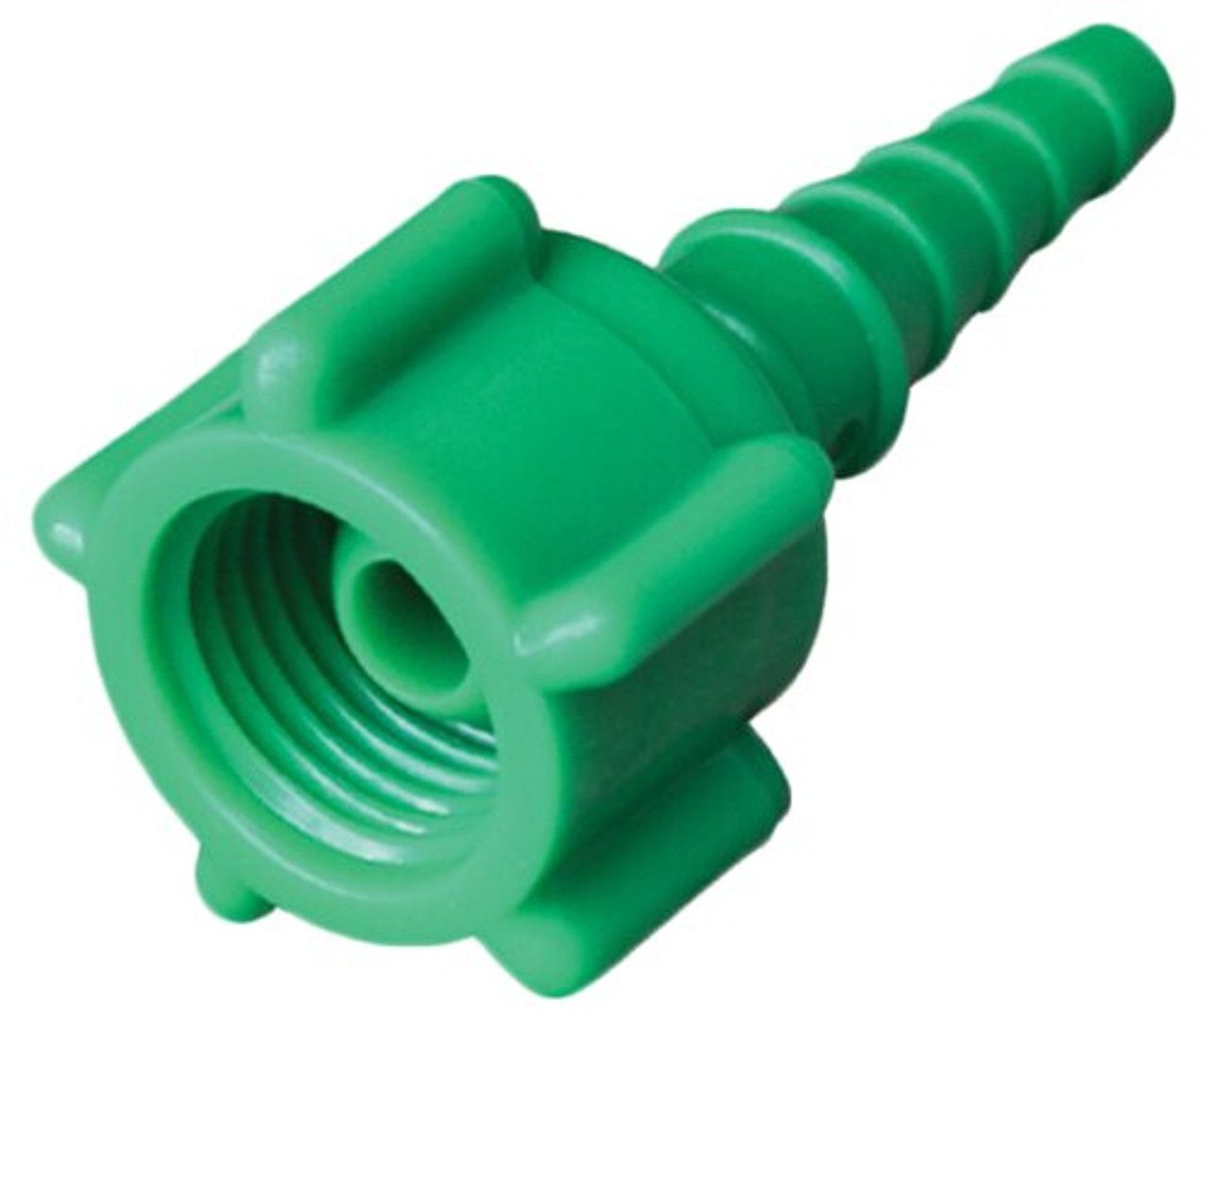

O2 Flowmeter Adapter
Oxygen Flowmeter Adapter
Plastic Tubing Nipple for Flowmeter
Oxygen Nut and Stem Adapter

Slide 36

My Favorite Example

Slide 37
Key Metrics
Supply Cost per Procedure
Inventory Days on Hand
Inventory Turn Rates/Ratio
Percentage of Spend on Contract
Rebate Tracker
Open PO report
Received, Not Invoiced
Purchase Order Submission Method

Slide 38
Supply Chain Management Information Systems (SCMIS) and Data Analysis Summary
The Five C’s
  Current
  Correct
  Clean
  Concise
  Consistent
Nomenclature
Key Metrics
  Accurate data for accurate reporting
“You can’t manage what you can’t measure” – Peter Drucker

Slide 39
The Supply Chain Maturation Curve
Basic functions are being performed; No SCMIS; Unsure of or No GPO relationship; high case costs
Has SCMIS with mostly accurate data; member of GPO and knows how to access portal; stockouts still occur but are less often; outdates still occur
SCMIS per the 5 C’s; infrequent stockouts or outdates; accurate case cost; performing benchmarking on costs and on procedures; has KPIs and are working towards improving or maintaining; value analysis process; strategic sourcing; QBRs with key reps; supply rooms are neat, orderly, well labeled, Best in Class
SCMIS in EMR; Outdated with errors; Membership in GPO but not validating pricing or contracts; expired product; regular stockouts
SCMIS is accurate; Physical Inventory being conducted; Active in GPO; Has list of contracts outside of GPO; working on case costing; infrequent stock outs or outdates; supply rooms are clean and orderly

Slide 40
How to help your Materials Manager
Speak their language – We speak in numbers
  Box tops
  Item or Manufacturer numbers
Make them part of management team
Give them time
ASCA Virtual Materials Manager Course

Slide 41
If you have questions or need help, please feel free to reach out:
RobertMayhew@RevoHealth.com

