Slide 1
MDH Updates for MNASCA
Nicole Osterloh| Federal Operations Supervisor & Lead ASC Supervisor

Slide 2
Agenda
CMS Mission and Priorities Document for 2023.
Survey Activities
Process for New Ambulatory Surgical Centers

Slide 3
2023 Mission and Priorities document Admin 22-10-ALL (cms.gov).

Slide 4
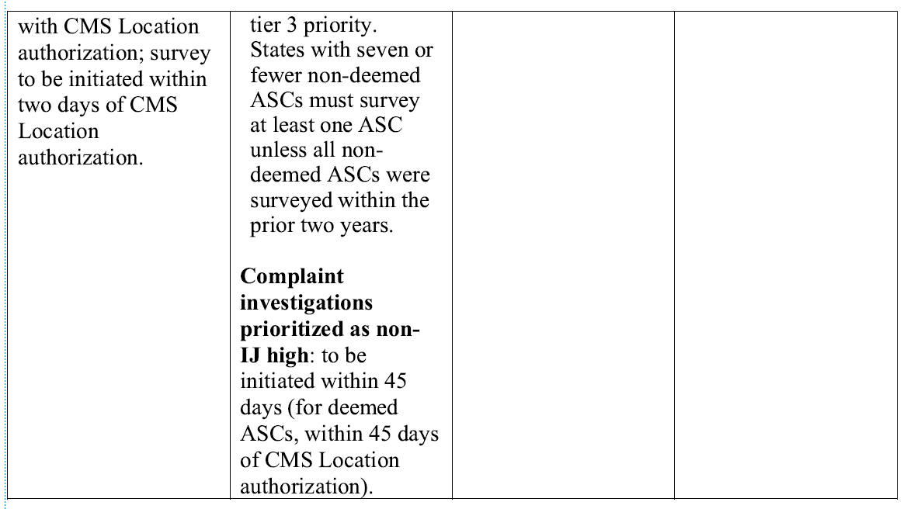
Cont. M&P

Slide 5
Cont. M&P
NOTE: NON-DEEMED ASC are the same as above for Tier 1, but do not require prior authorization by the CMS RO.

Slide 6
Survey Activity x 1 year
MDH has investigated 3 Immediate Jeopardy Complaints with ASC within the last year.
MDH cited a deficiency at 1 of the 3 complaints related to Physical Environment, at a condition level related to mold.

Slide 7
Survey Activity x 1 year
The MDH has completed 11 State Licensure Walkthroughs for new construction.
*There are 5 pending licensure walkthroughs currently.

Slide 8
Initial Steps in New Construction ASC
MDH receives the application and fee to our administration support staff.
The admin support staff then forwards the application and fee to the deposit team.
The deposit team then applies the payment.
The admin support scans your application into the federal licensing daily mail folder.

Slide 9
Initial Steps in New Construction ASC
5. A Credentialer is assigned your application and assigns a Health Facility ID Number (HFID).
6. The Credentialer then sends a notification referral to Engineering, the MN Fire Marshal, and the Health Supervisor for Ambulatory Surgical Centers (Nicole Osterloh) to notify them of the upcoming new ASC and their anticipated date of opening.
7. Engineering reviews your plans and makes corrections, etc. until plans are approved.
8. Engineering must complete their paperwork and submit it to the MN Program Assurance (PA) staff (usually Amy Johnson).

Slide 10
Initial Steps in New Construction ASC
9. The Fire Marshal’s office then received the go ahead from PA to perform a walkthrough Life Safety Code survey. Depending on the results of the survey, items may need to be fixed or they can issue their clearance and submit their paperwork to PA.
10. PA then notifies the Health Supervisor to conduct the Health final portion of a State initial licensing walk through. ****Note: the ASC must be fully operational for MDH to conduct the initial licensing walk thru (Everything from instruments, to surgical supplies, contracts, Emergency Preparedness, credentialing of physicians and staff, etc. MUST be completed before we can do a health walkthrough). Surveys are booked 1 calendar month in advance per CMS requirements, so Nicole works with her trained ASC staff to check their availability of their schedules. Sometimes this can take a few weeks to get scheduled.

Slide 11
Initial Steps in New Construction ASC
11. Once a surveyor is assigned, they will reach out to you via email on a date and time to do your walkthrough, and documents they will be requesting be available upon entrance. (This is the only time we announce a survey).
12. The Health team then conducts the initial licensing Health survey. Some things may require adjusting, or they recommend licensure and notify PA staff of the survey results based of Health Walkthrough.
13. PA staff works to close the Health portion of the process and issues a license.
14. At this time, the ASC must work with an accrediting organization to perform the initial certification survey vs the State Agency, MDH.

Slide 12
MDH ASC MAIN PAGE
Freestanding Outpatient Surgical Center Licensing - MN Dept. of Health (state.mn.us)
On this page:
Federal Certification Process for Ambulatory Surgical Centers for additional information and forms required for participation as a Medicare-certified Ambulatory Surgical Center.
Other Required forms and documents.
Related statutes and rules.

Slide 13
Contacts
Amy Johnson: HRD Health Program Rep amy.lee.johnson@state.mn.us
Shellae Dietrich: HRD Health Program Manager shellae.dietrich@state.mn.us
Nicole Osterloh: HRD Federal Operations Supervisor nicole.osterloh@state.mn.us
Maria King: HRD Division Director maria.king@state.mn.us

Slide 14
Thank You!
Nicole Osterloh- Federal Operations Supervisor
nicole.osterloh@state.mn.us
507-476-4230

