Slide 1
CRNAs
COST INFORMATION FOR ANESTHESIA MODELS
Certified Registered Nurse Anesthetists
Are the Most VERSATILE and COST-EFFECTIVE ANESTHESIA PROVIDERS
Cost Effectiveness of Anesthesia Models
CRNAs are qualified to work in any practice setting/model
CRNAs are not required to practice under a
physician anesthesiologist; by law, CRNAs can work independently of OR together with physician anesthesiologists
CRNAs have a proven safety record
CRNAs in Anesthesia Care Team Model ensure NO LOSS IN REVENUE, NO RISK OF FRAUD, no delays in delivery of care even when there is a supervision lapse (up to 70%³ of the time) as long as QZ billing is utilized
In such cases, the facility simply bills exclusive of the anesthesiologist for the procedure (QZ vs. medical direction). The QZ modifier is exclusive to CRNAs
Autonomous/CRNAs Collaborating with Surgeons
CRNAs
Collaborating with Anesthesiologists
CRNA
CRNA
12
ANES¹
1
12
Staffing Cost²
Staffing Cost²
2.00M
Physician Anesthesiologist Only
2.40M
Anesthesia Care Team
( 3:1 Ratio)
ANES¹
CRNA
12
ANES¹
4
12
Staffing Cost²
5.04M
Staffing Cost²
3.68M
Physician anesthesiologist
Staffing costs are based on salary only. ThemedianCRNA salary ($166,540) was takenfrom the 2018 AANA Compensation and Benefits Survey. Salary costs for physician anesthesiologists are based on the 75thpctlsalary ($420,284) according to HR Reporteddata as of March 29, 2018 form Salary.com
Epstein R, DexterF.(2012). Influence of supervision ratios by anesthesiologist on first case starts and critical portions of anesthetics. Anesthesiology,
116(3):683-691.
Copyright© AANA 2022

Slide 2
How is anesthesia Billed?
Billing Calculation
Base Units
Time Units
Modifying Units
Conversion Factor
Billed Amount*
*Contractual agreements may exist with insurance companies that specify payment of an agreed rate per unit. Adjust the calculation above to calculate the allowed amount. There may be a difference in billed amount and allowed amount.

Slide 3
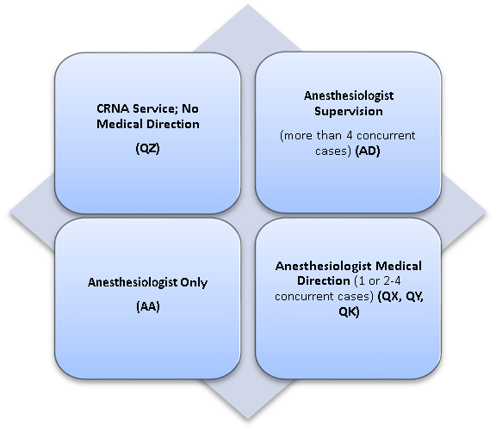
Types of Billing Models Not Practice Models
Anesthesia Services Delivery Reimbursement
In MN the ASC chooses the
Billing and Practice Models

Slide 4
Practice Model Reimbursement
Practice Model | Anesthesiologist Allowed | CRNA Allowed
CRNA service; No medical direction | N/A | 100%
Anesthesiologist only | 100% | N/A
Medical direction | 50% | 50%
Payment at the medically supervised rate* | 3 units (+ 1 unit for induction) | 50%
Medicare pays for medical direction of CRNAs at 50% of the reimbursement for the case. To meet medical direction requirements of two to four concurrent cases, the anesthesiologist must meet the TEFRA rules. No more than 4 cases (CRNAs) can be medically directed at one time. An anesthesiologist must document the seven steps, which should be present in the anesthesia record. Two separate claims need to be filed for medically directed anesthesia procedures (one for the anesthesiologist and one for the CRNA).

Slide 5
Tefra Requirements for Medical Direction
Performs a pre-anesthetic examination and evaluation;
Prescribes the anesthesia plan;
Personally participates in the most demanding procedures in the anesthesia plan, including, if applicable, induction and emergence;
Ensures that any procedures in the anesthesia plan that he or she does not perform are performed by a qualified individual;
Monitors the course of anesthesia administration at frequent intervals;
Remains physically present and available for immediate diagnosis and treatment of emergencies; and
Provides indicated-post-anesthesia care.

Slide 6
The American Association of Nurse Anesthesiology recently developed Efficiency-driven Anesthesia Modeling, a new way of approaching anesthesia staffing.
Efficiency-driven Anesthesia Modeling (EDAM)

Slide 7
EFFECTIVENESS
Studies show that increasing CRNA involvement and reducing restrictions on CRNA-provided services results in care as safe and equitable to that delivered by physician anesthesiologists or in more restrictive models.
EFFICIENCY
Because Efficiency-driven Anesthesia Modeling uses CRNA providers, it may reduce (or even eliminate) the financial burden placed on facilities, help reduce unnecessary healthcare spending and reflect appropriate anesthesia staffing to meet a facility’s patient and surgical needs.
EQUITY
CRNAs provide most anesthesia services in rural America and often work in areas with vulnerable populations. CRNA care may result in cost savings and reallocation of budget dollars to additional coverage for anesthesia services and/or other crucial healthcare areas.

Slide 8
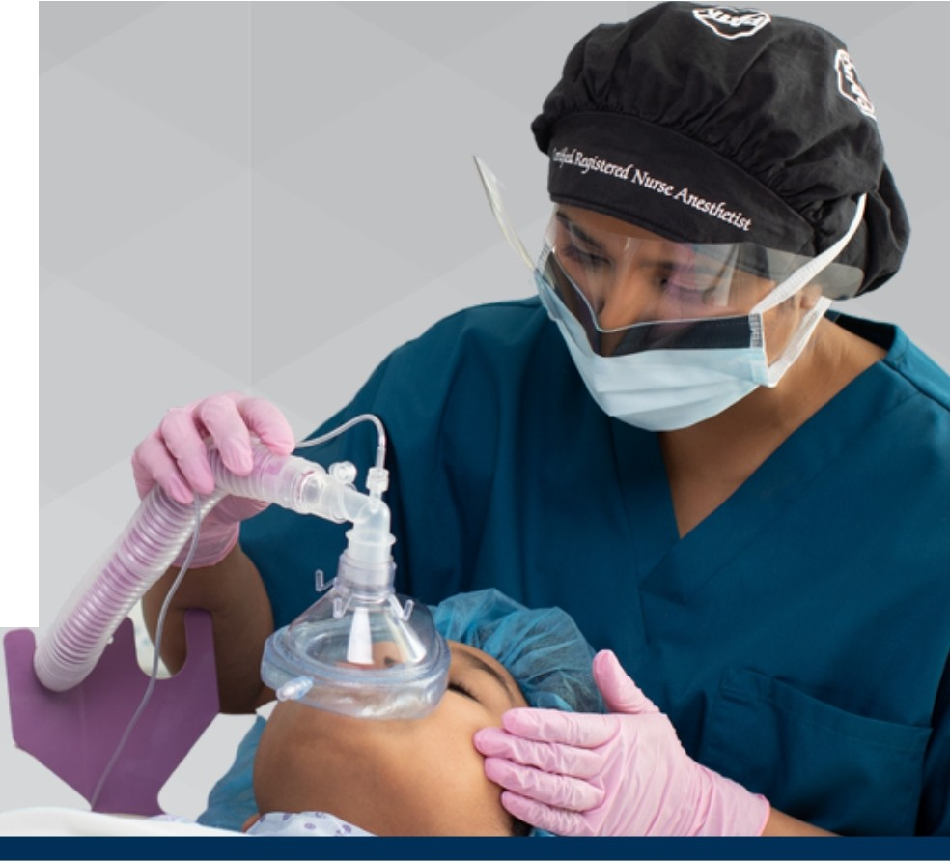
CRNA
Certified
Registered
Nurse
Anesthetist
FAST FACTS
1
2
3
4
s
There is no statistically significant difference in the risk of anesthesia complications based on the degree of restrictions placed
on CRNAs by state SOP laws. (Negrusa et al, Medical Care Journal, 2016)
Nurse anesthetists have been providing anesthesia to patients in the United States for more than 150 years.
CRNAs are advanced practice registered nurses who administer more than 50 million anesthetics to patients each year. More than 61,000 U.S. nurse anesthetists and student nurse anesthetists
are members of the American Association of Nurse Anesthesiology ( AANA ).
There is no difference in patient outcomes when anesthesia services are provided by CRNAs, physicians, or CRNAs supervised by physicians. (Dulisse, 2010 - Health Affairs)
In some states, CRNAs are the sole anesthesia professionals in nearly 700% of rural hospitals, ensuring patient access to obstetrical, surgical, trauma stabilization, and pain management services.
Nurse anesthesia care is 25 percent more cost effective than the next least costly anesthesia delivery model. (Hogan, 2016- Nursing Economic$)
CRNAs have been recognized Medicare Part B providers since 1986 .
Practicing in every setting, with and without anesthesiologists, CRNAs ensure patient access to healthcare and predominate in rural and other medically underserved areas.
CRNAs work in every setting in which anesthesia is delivered, including hospitals, ambulatory surgical centers and physician offices.
Nurse anesthesia predominates in Veterans Hospitals and in the U.S. Armed Forces.
Researchers studying anesthesia safety found no differences
in care between CRNAs and anesthesiologists. (Lewis, 2014- Cochrane Database of Systematic Reviews)
CRNA services include pre-anesthesia
evaluation, administering the anesthetic, monitoring and interpreting the patient's vital signs and managing the patient throughout surgery.
AA
.... A Ame,icanAs«><iotionor
Learn more about CRNAs at AANA.com
l A
NURSE ANE.STH ES10 1.0 GY
American Association of Nurse Anesthesiology I Office of Federal Go v ern m ent Affairs
25 Massachusetts Avenue NW, Suite 320 I W ashing t o n, DC 20001 I 20 2 . 4 84 .84 0 0 I info @aanadc .com

Slide 9
CRNAs: Ensuring Safe Anesthesia Care
WHY SURGEONS AND OTHER HEALTHCARE PROVIDERS RELY ON CRNAs
Certified Registered Nurse Anesthetists (CRNAs) are advanced practice registered nurses who collaborate with surgeons, obstetricians, dentists and other healthcare providers to deliver safe, high-quality and cost-efective anesthesia care to patients in virtually every healthcare setting.
Access to Care
CRNAs practice in all 50 states and in the military, safely providing more than 50 million anesthetics each year.
Patient Safety
National studies confirm that CRNAs
Anesthesia care is nearly 50x safer
are integral to high-value anesthesia
than it was in the 1980s.**
care delivery where quality and safety
are emphasized.*
This is due to advancements in monitoring
technology, anesthetic drugs, provider education, and standards of care.
Risk Management
CRNA
CRNAs are educated, trained and experienced in providing anesthesia care for complicated medical procedures and handling emergency situations.
As licensed professionals, CRNAs are responsible and accountable for decisions made and actions taken in their professional practice.
Case law shows that surgeons and other healthcare providers face no increase in liability when working with a CRNA versus a physician anesthesiologist.
For a surgeon (or other healthcare provider) to be liable for the acts of an anesthesia professional, the surgeon must control the actions of the CRNA or anesthesiologist and not merely supervise or direct them.
Courts apply the same standard to judge whether a surgeon is liable for the acts of a CRNA or an anesthesiologist.
On a nationwide basis, the average 2020 malpractice liability insurance premium for
self-employed CRNAs was 36 percent less than it was in 1988. When trended for inflation through 2020, the reduction in premium is 71 percent.
$
Cost Savings
Healthcare facilities that hire anesthesiologists to supervise CRNAs in an efort to manage risk may more than triple the costs of anesthesia delivery without improving patient outcomes, lowering risk or reducing liability coverage costs.
*RTI
**Institute of Medicine www.anesthesiafacts.com
American Association of Nurse Anesthesiology© 2022
anesthesiafacts.com

